Slide 1
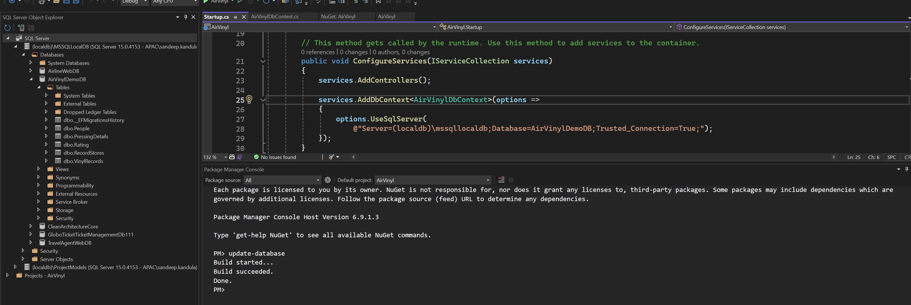

Slide 2
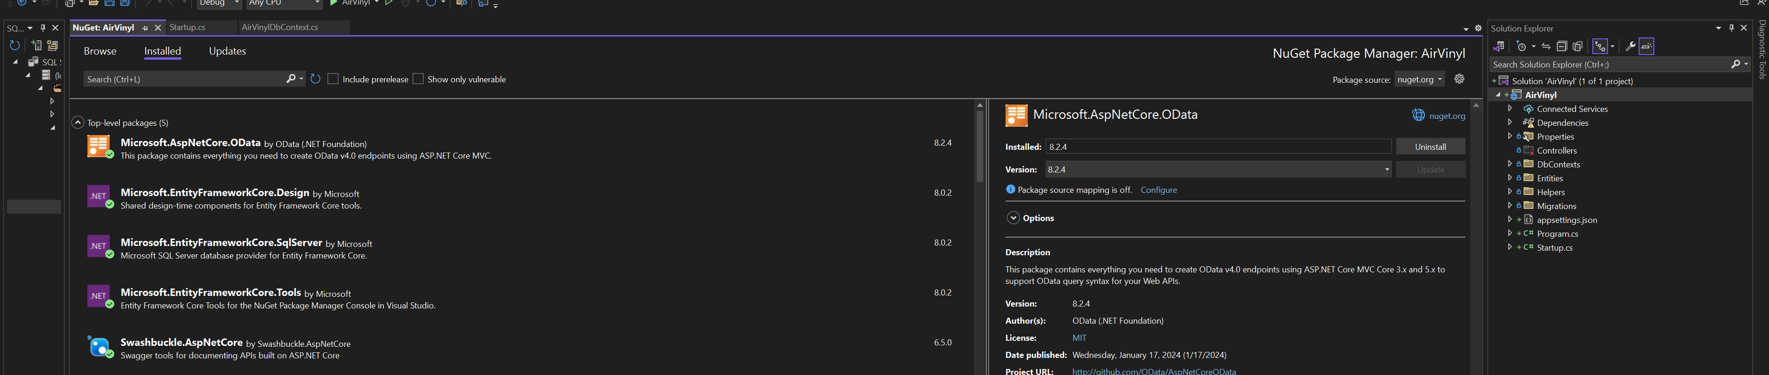

Slide 3
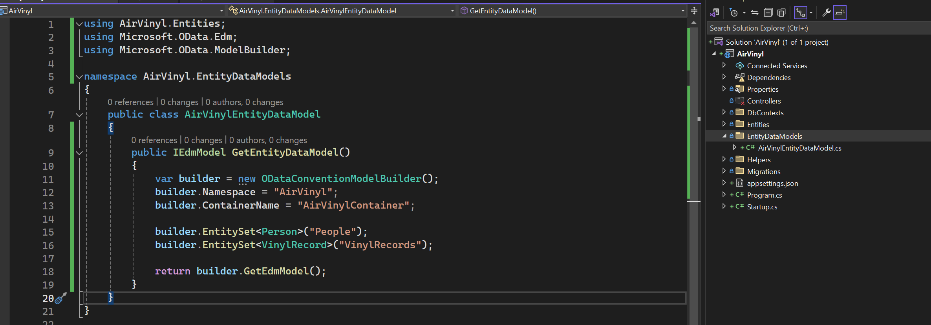
Defining EDM model

Slide 4
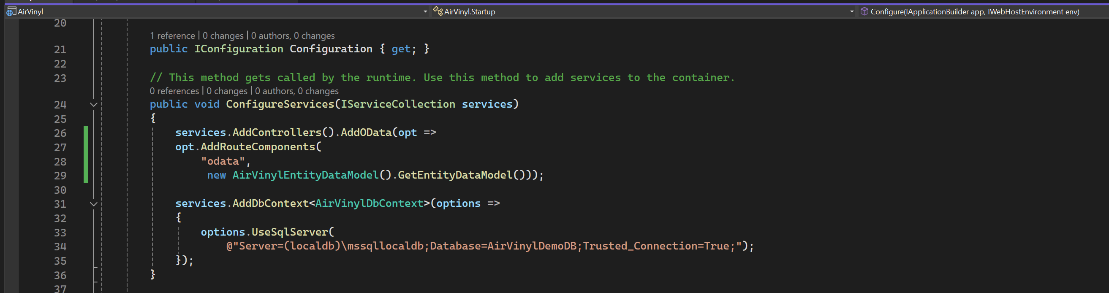

Slide 5
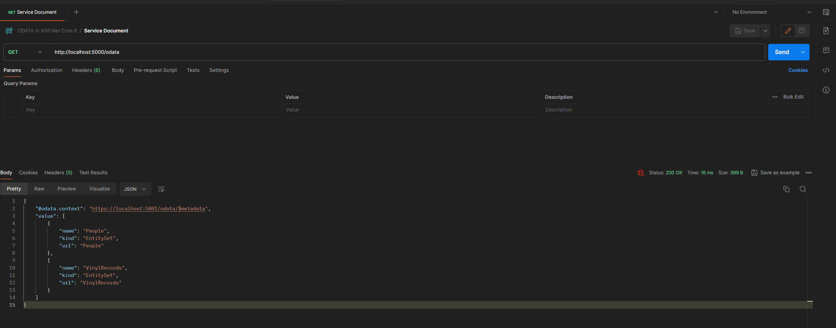
Service Document

Slide 6
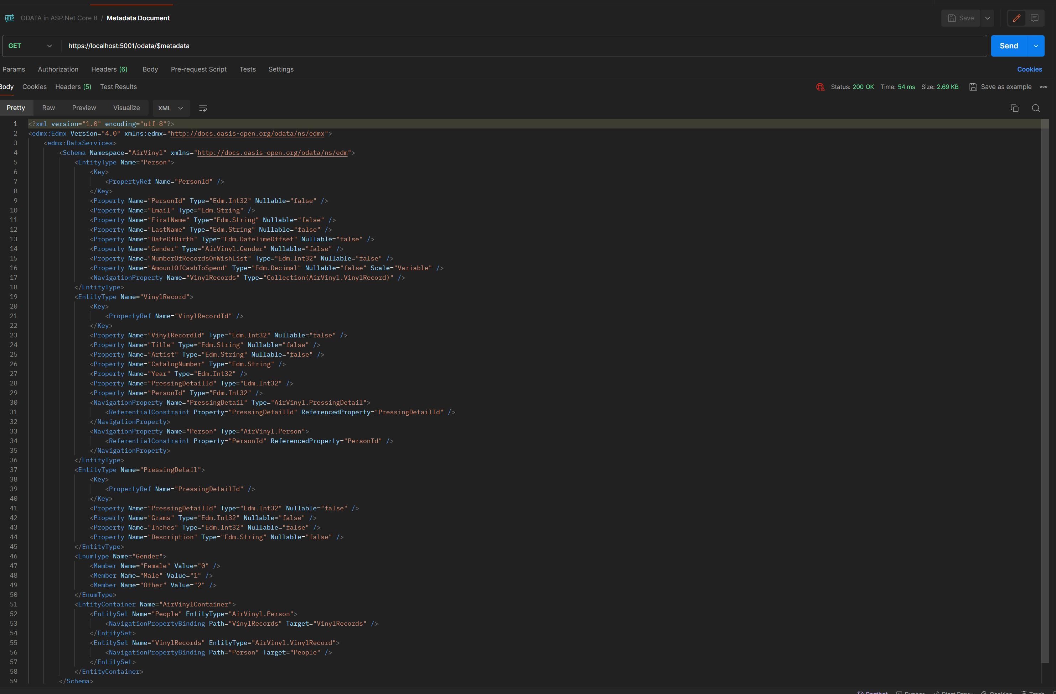
Metadata document

Slide 7
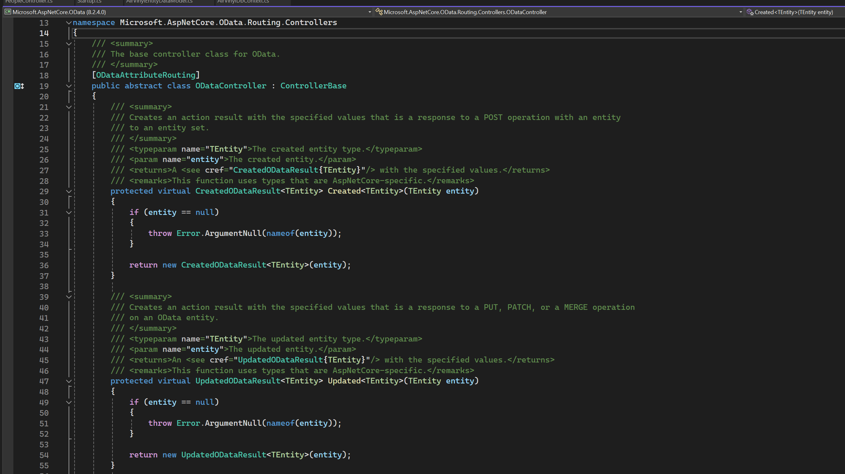
ODATAController

Slide 8
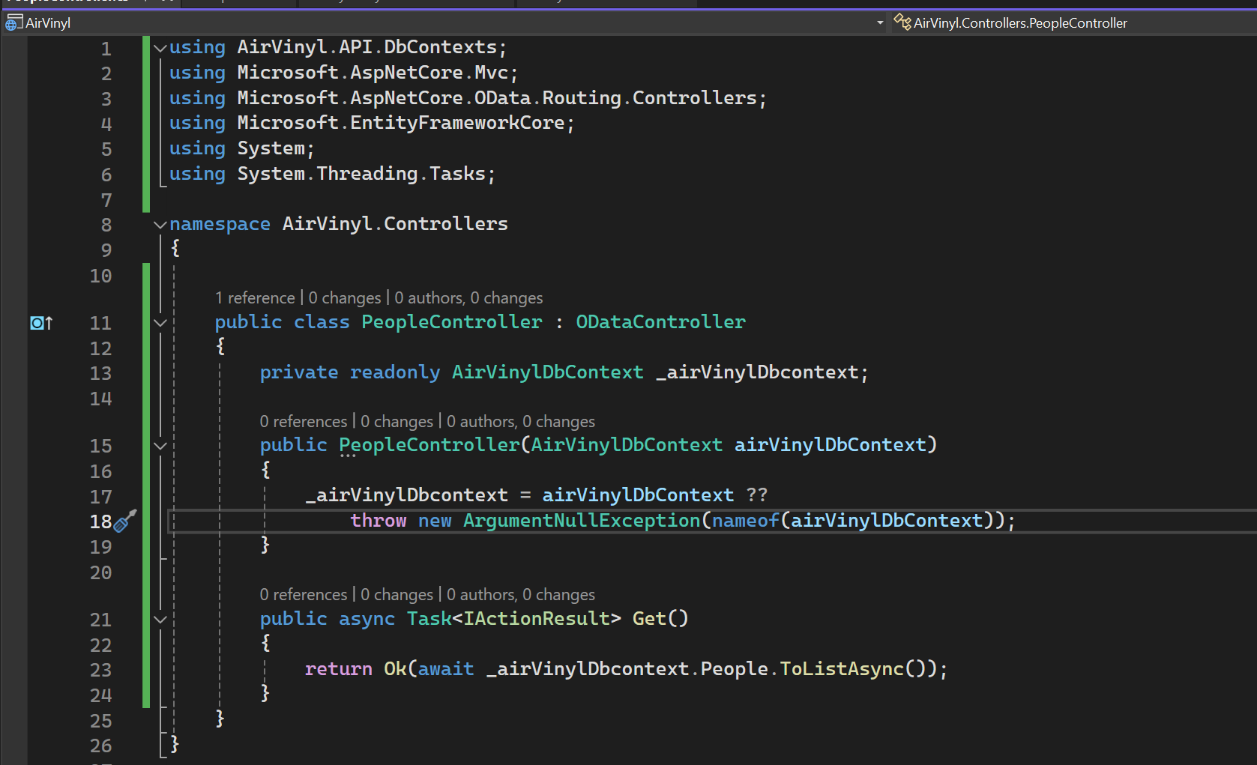
GET

Slide 9
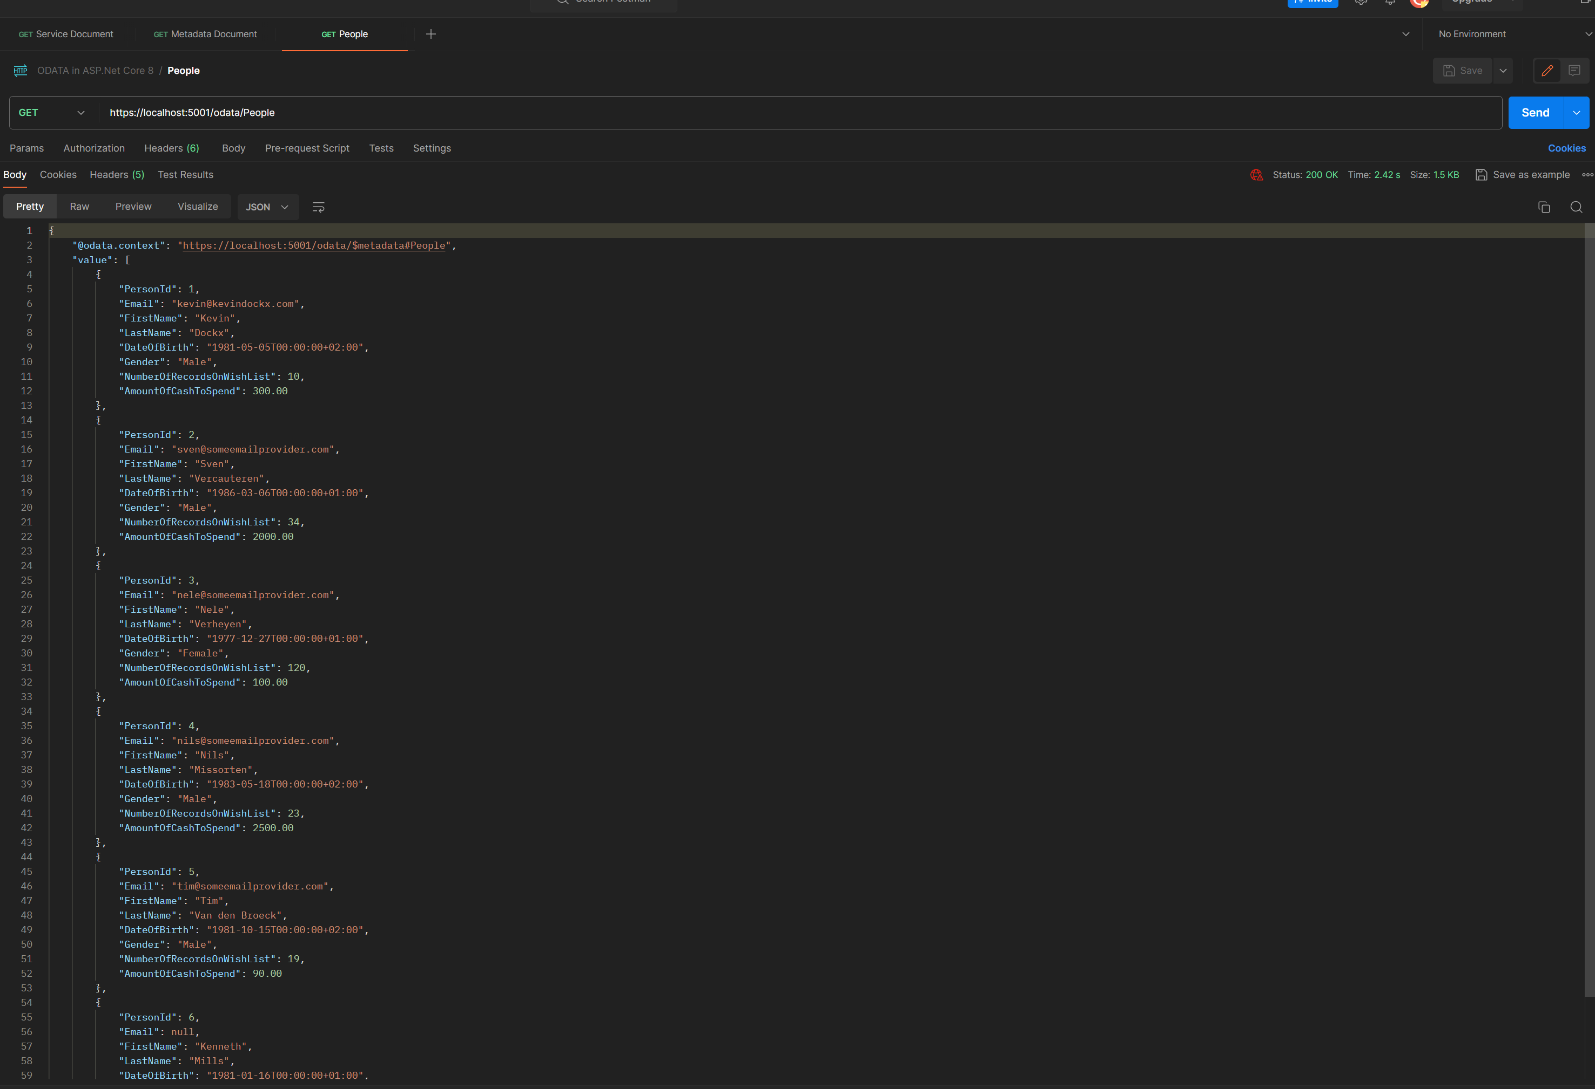
POSTMAN GET

Slide 10
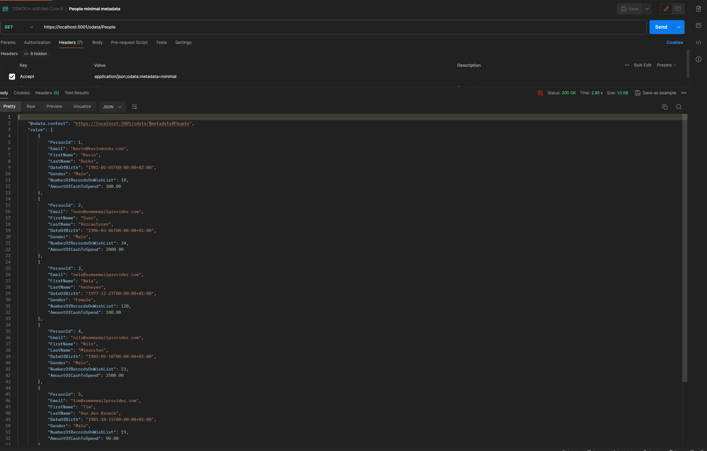
ODATA METADATA MINIMAL

Slide 11
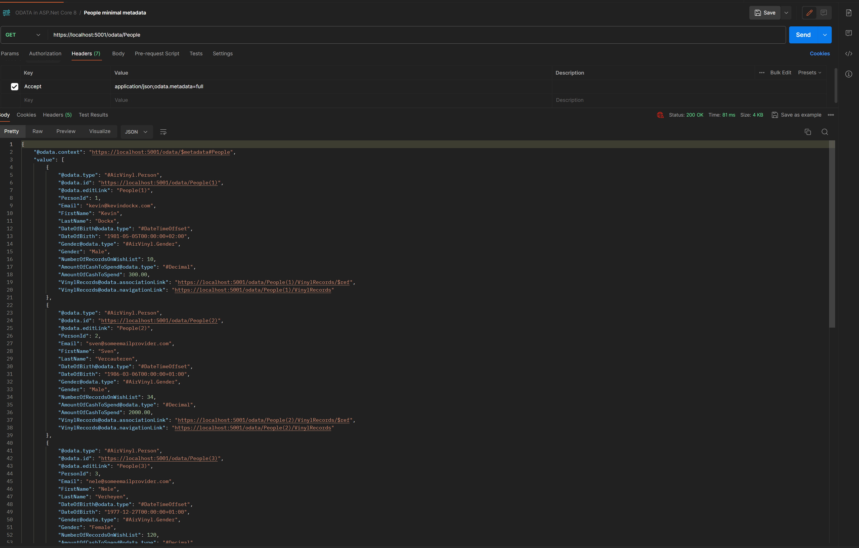
ODATA METADATA FULL

Slide 12
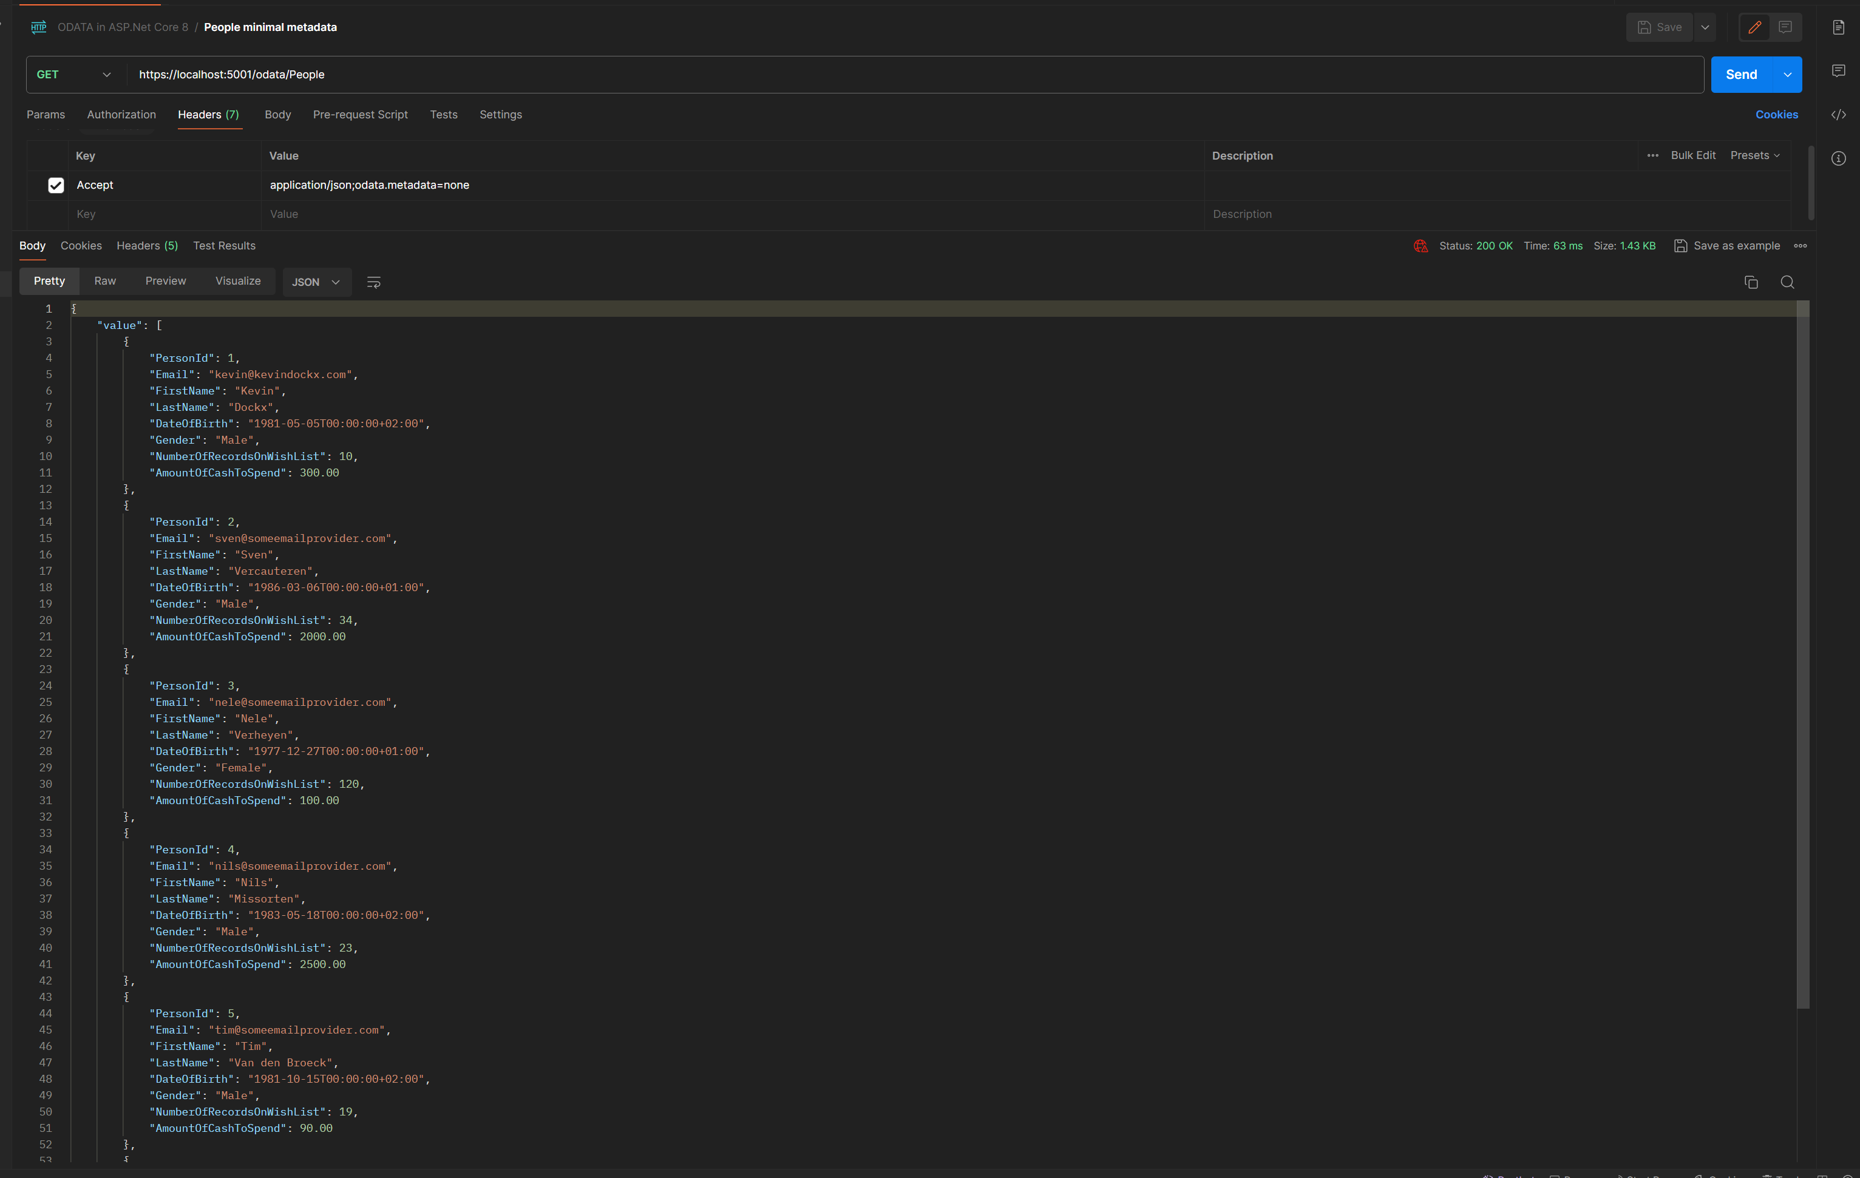
ODATA METADATA NONE

Slide 13
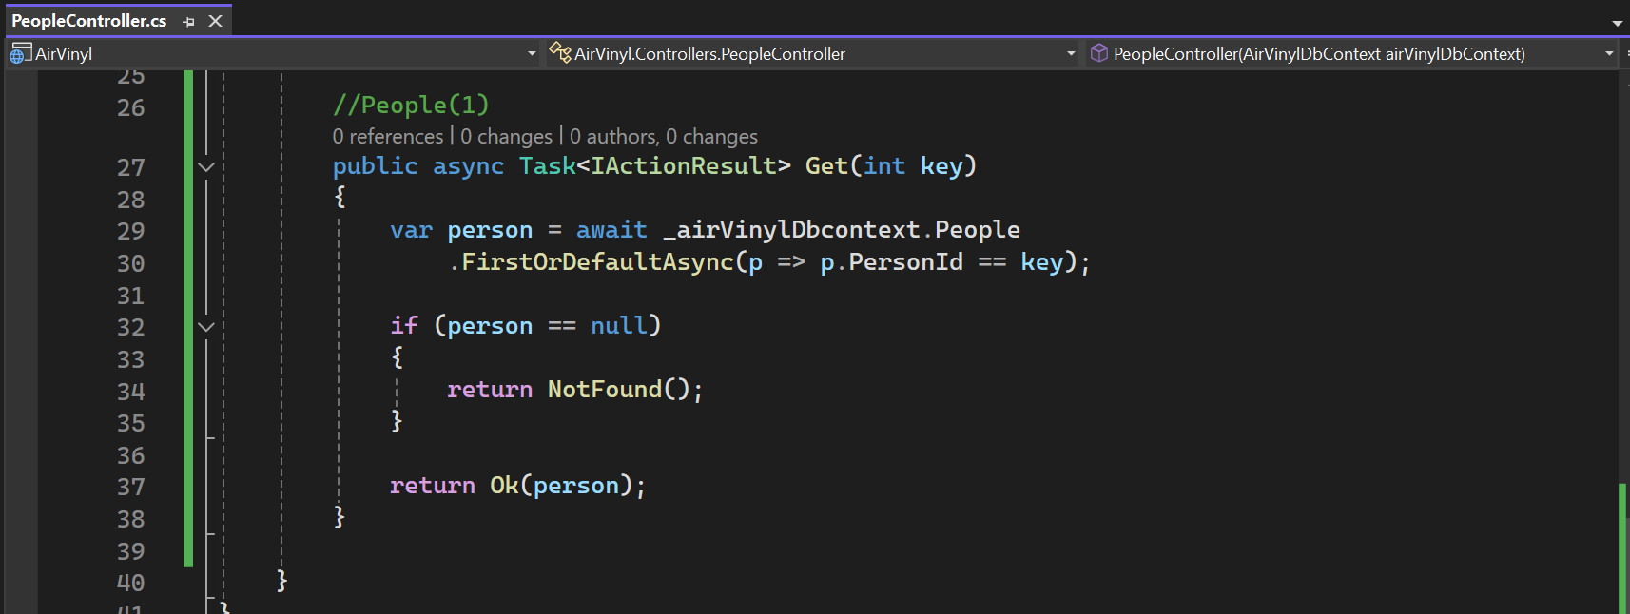
Get an individual Key - 1

Slide 14
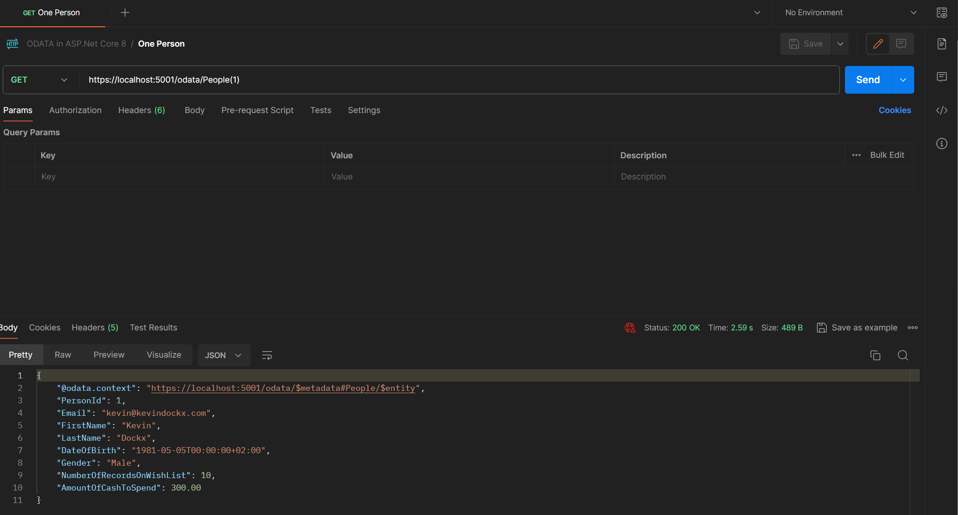
Get an individual Key - 2

Slide 15
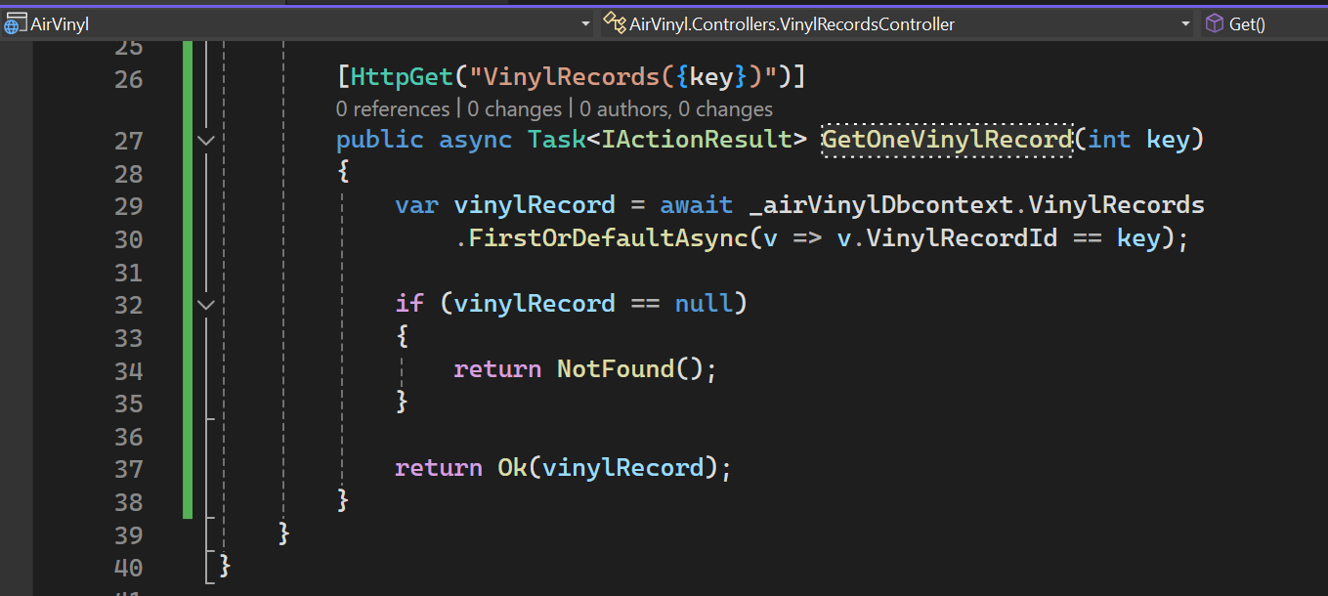
Get an individual Key - 3

Slide 16
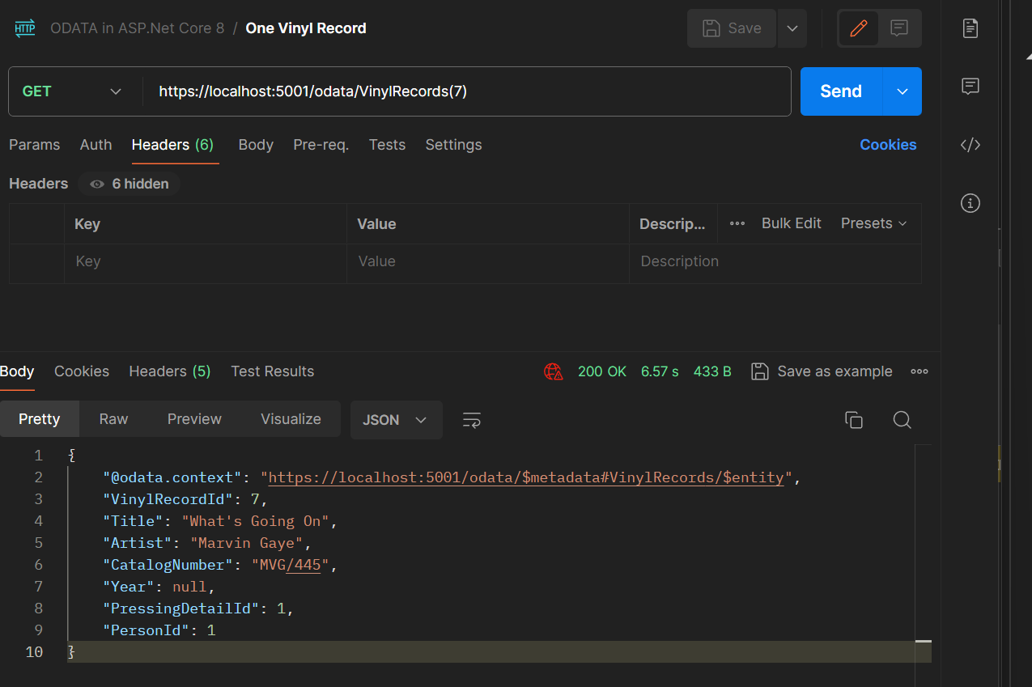
Get an individual Key - 4

Slide 17
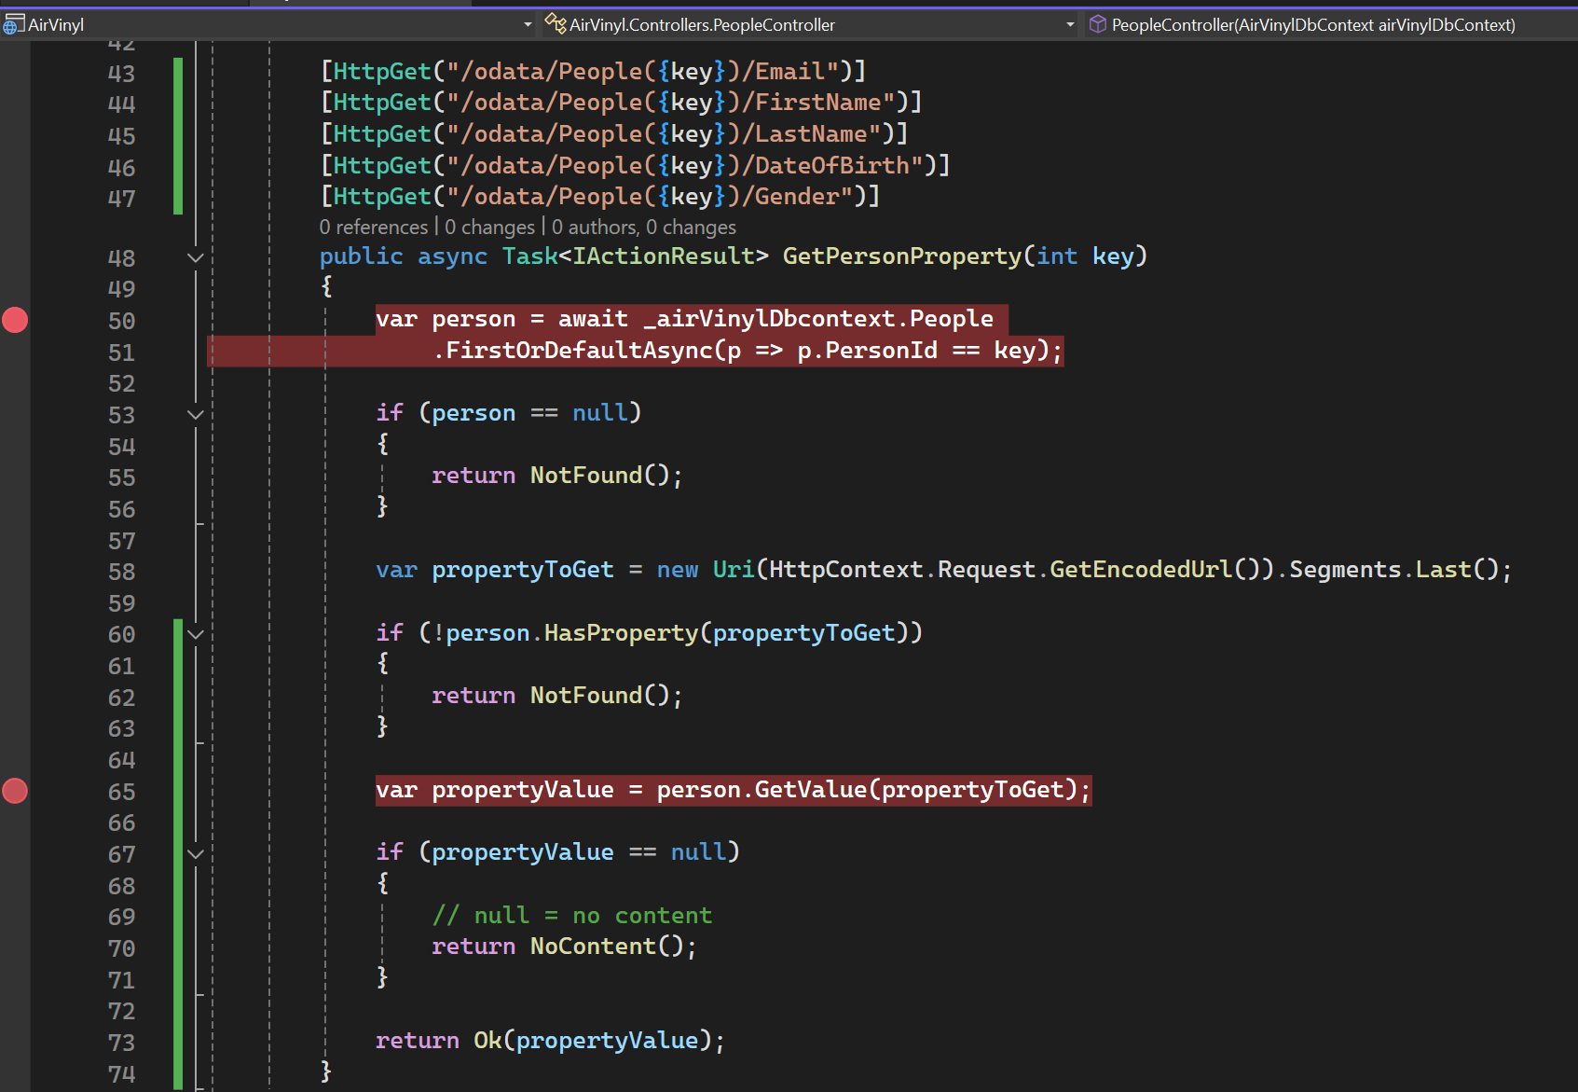
Getting individual properties - 1

Slide 18
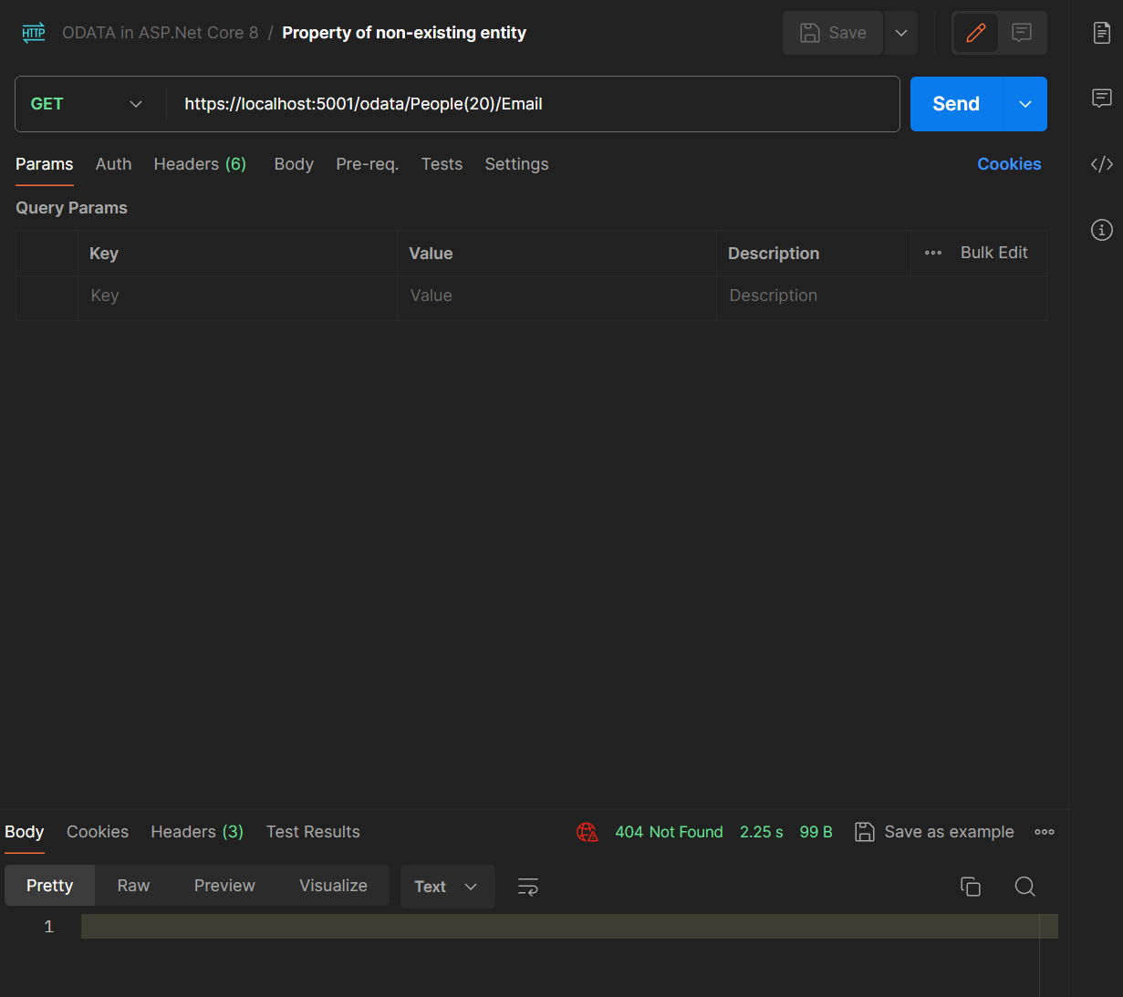
Getting individual properties - 2

Slide 19
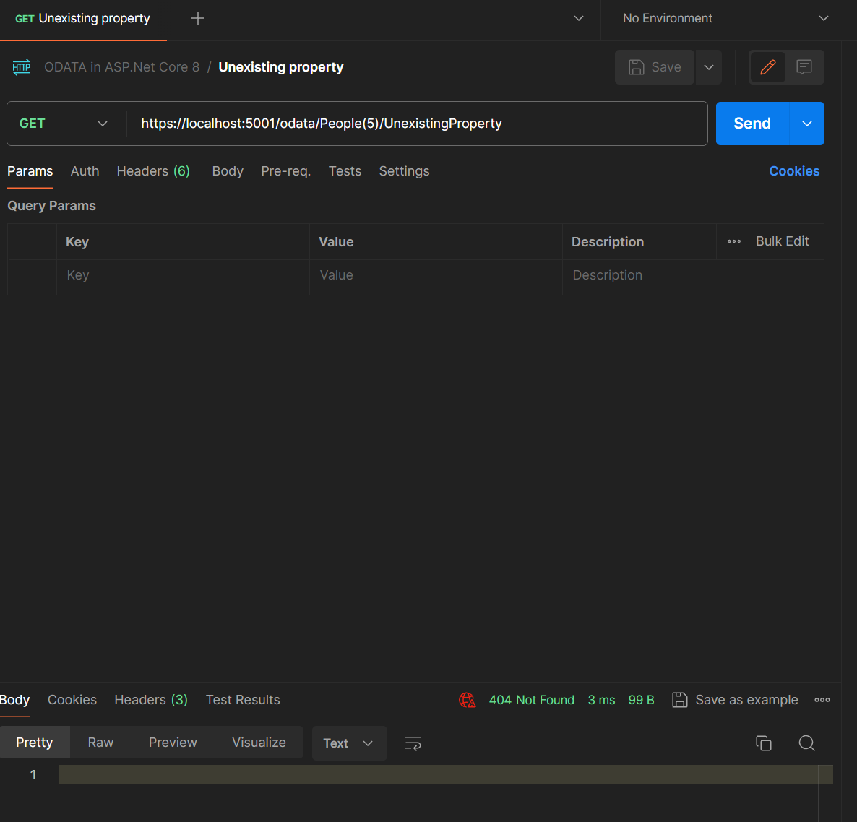
Getting individual properties - 3

Slide 20
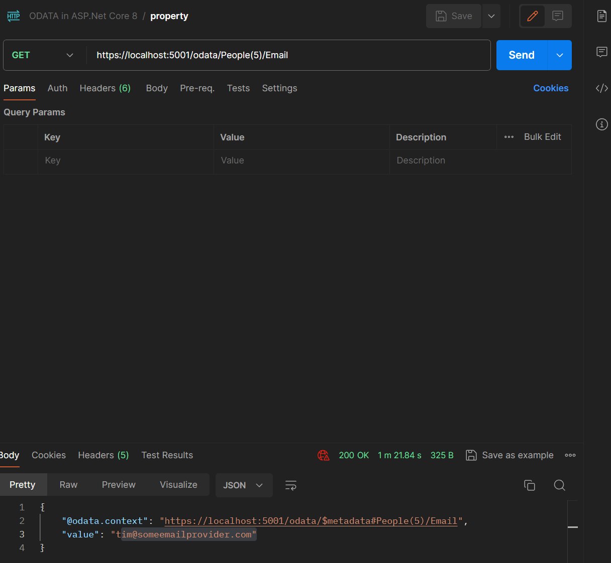
Getting individual properties - 4

Slide 21
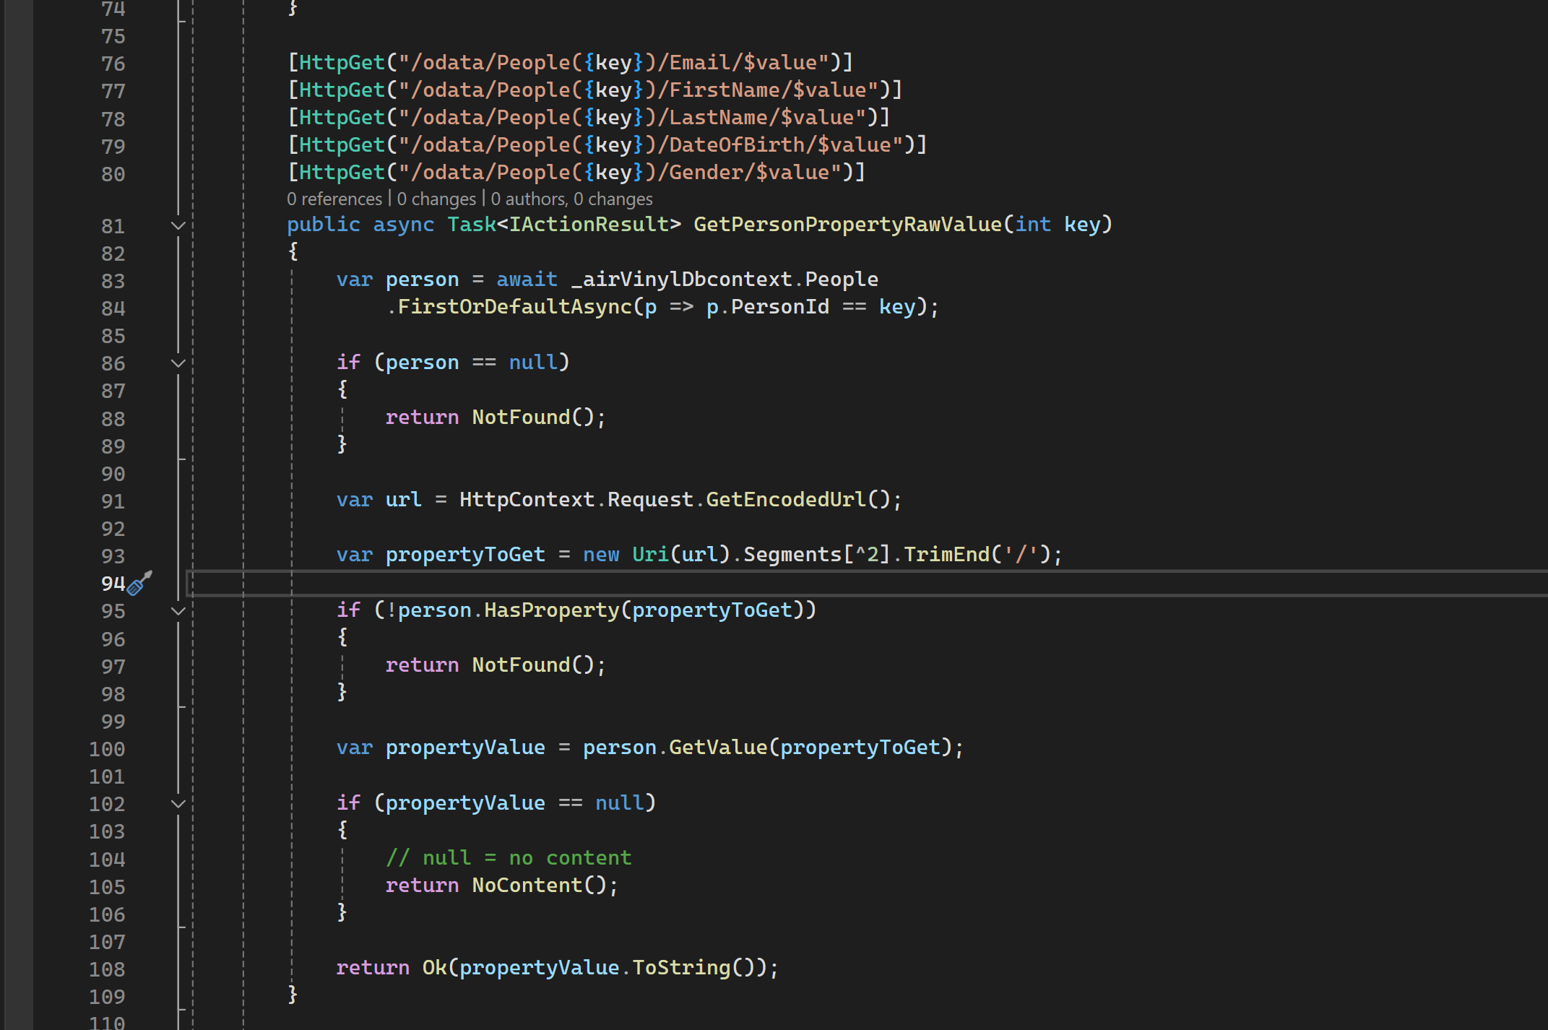
Getting Raw Property values

Slide 22
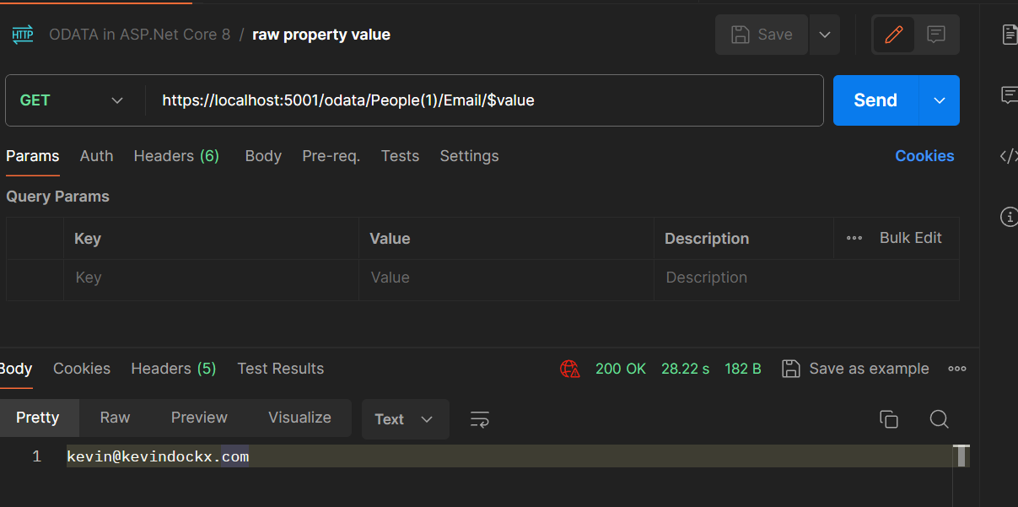
Getting Raw Property values

Slide 23
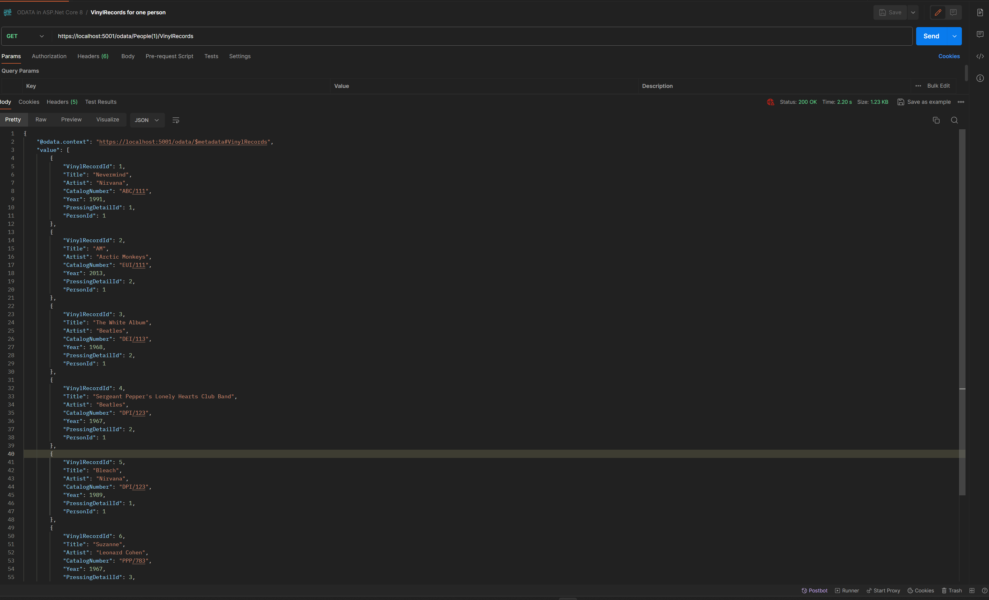
Getting Child Collection Properties

Slide 24
Manipulating OData resources

Slide 25
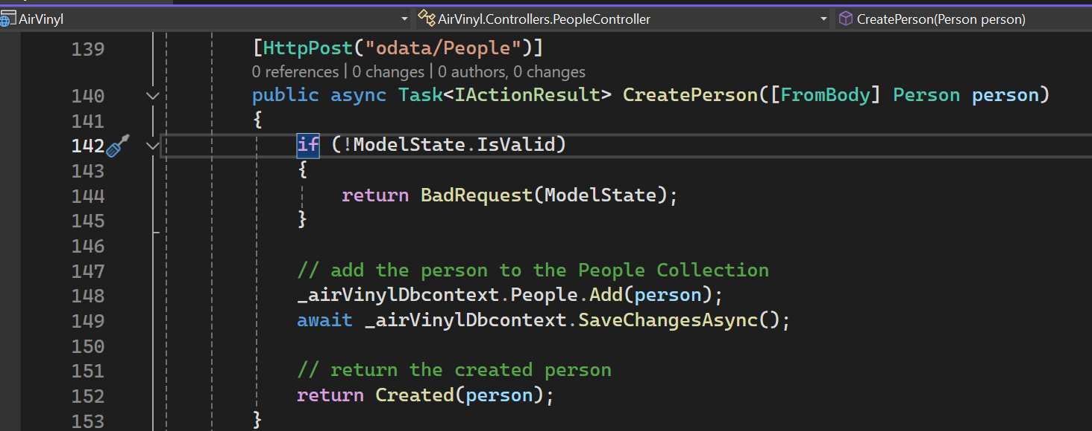
Creating a resource

Slide 26
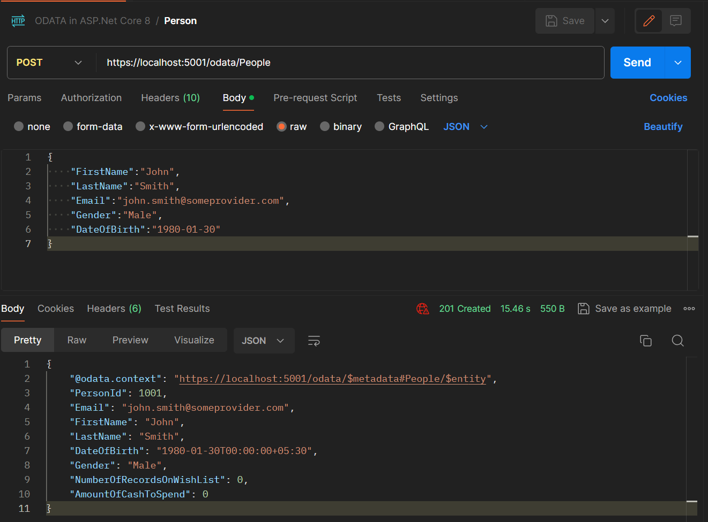

Slide 27
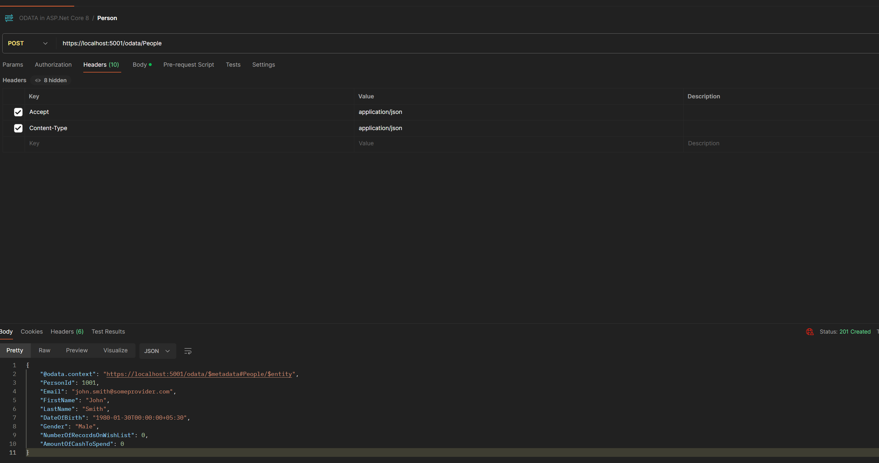

Slide 28
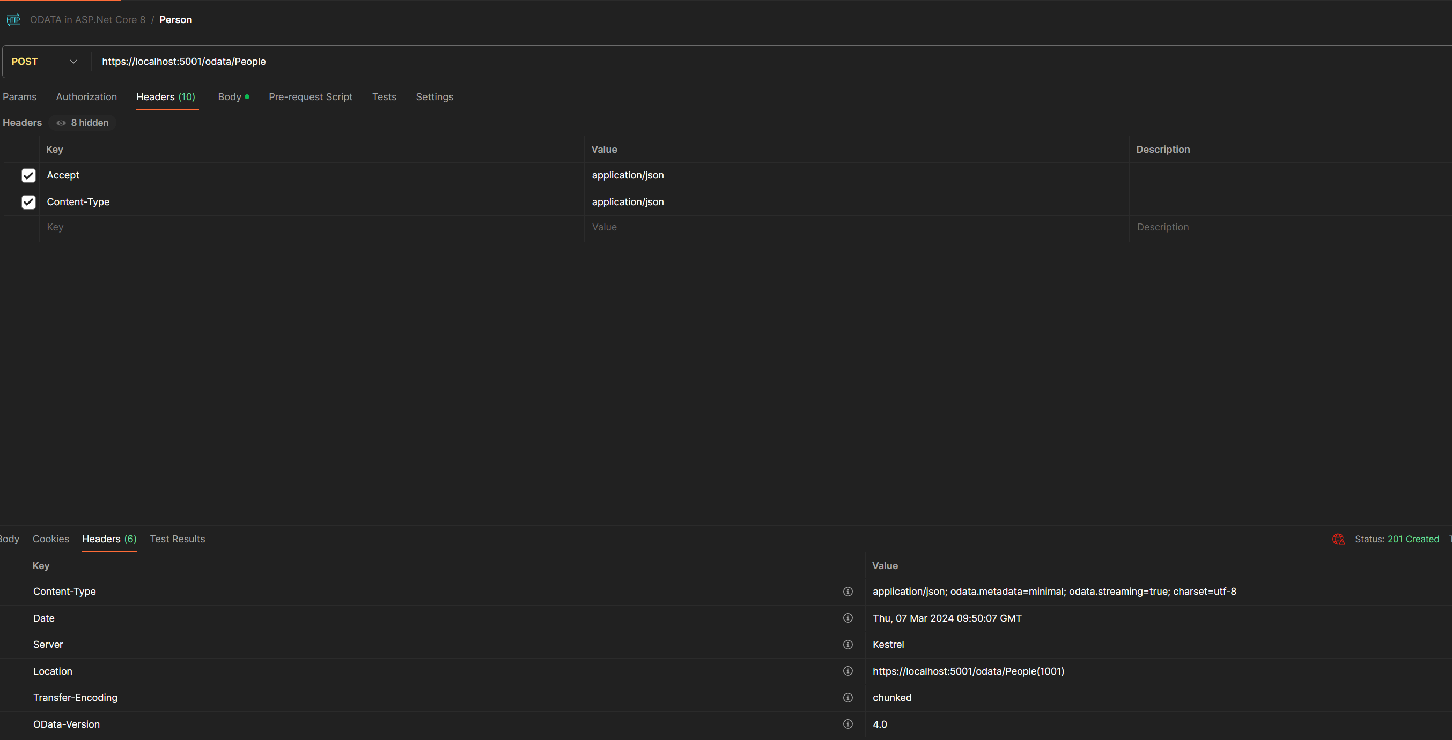

Slide 29
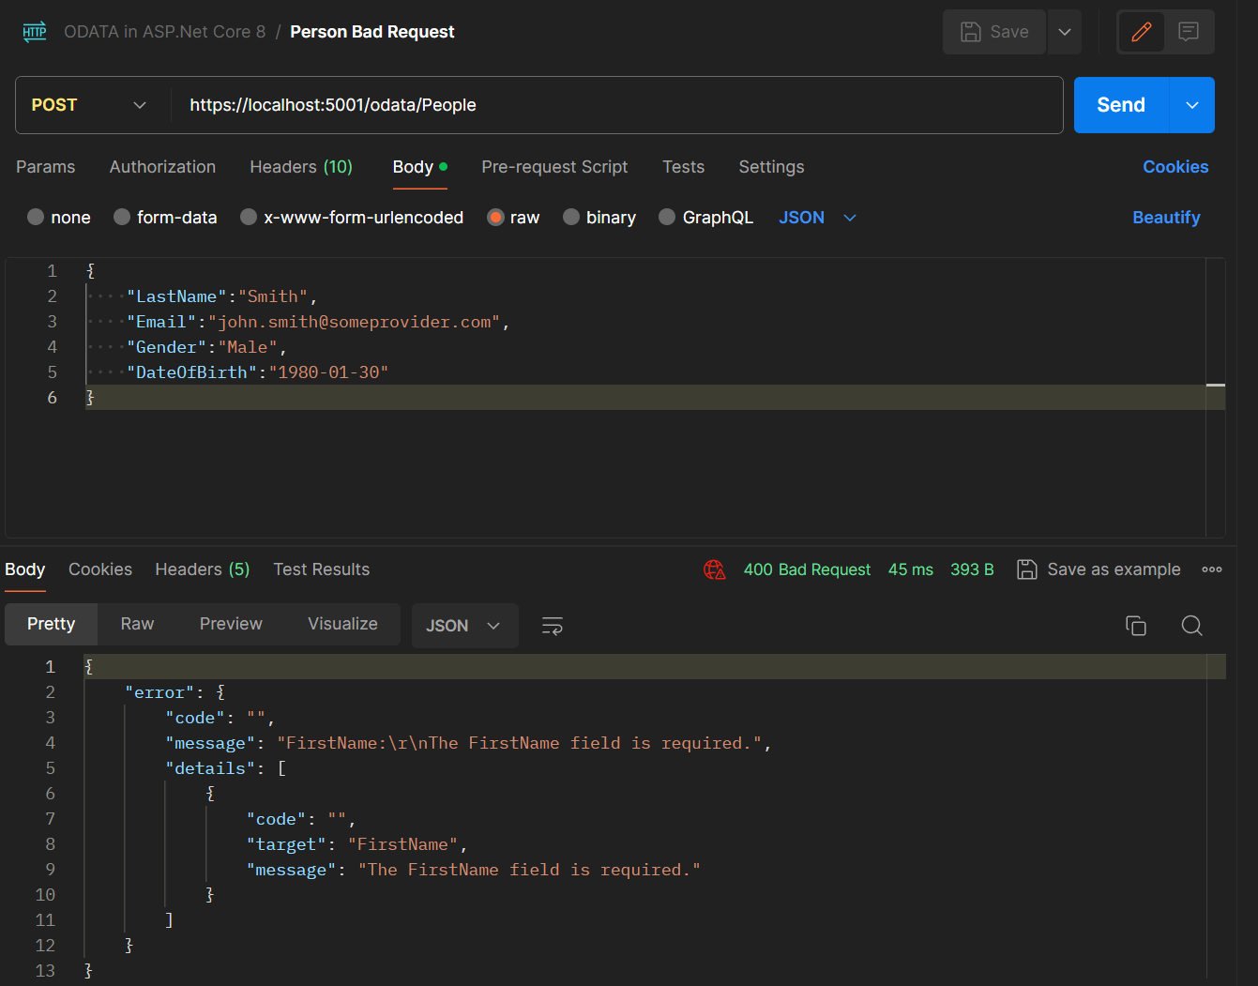

Slide 30
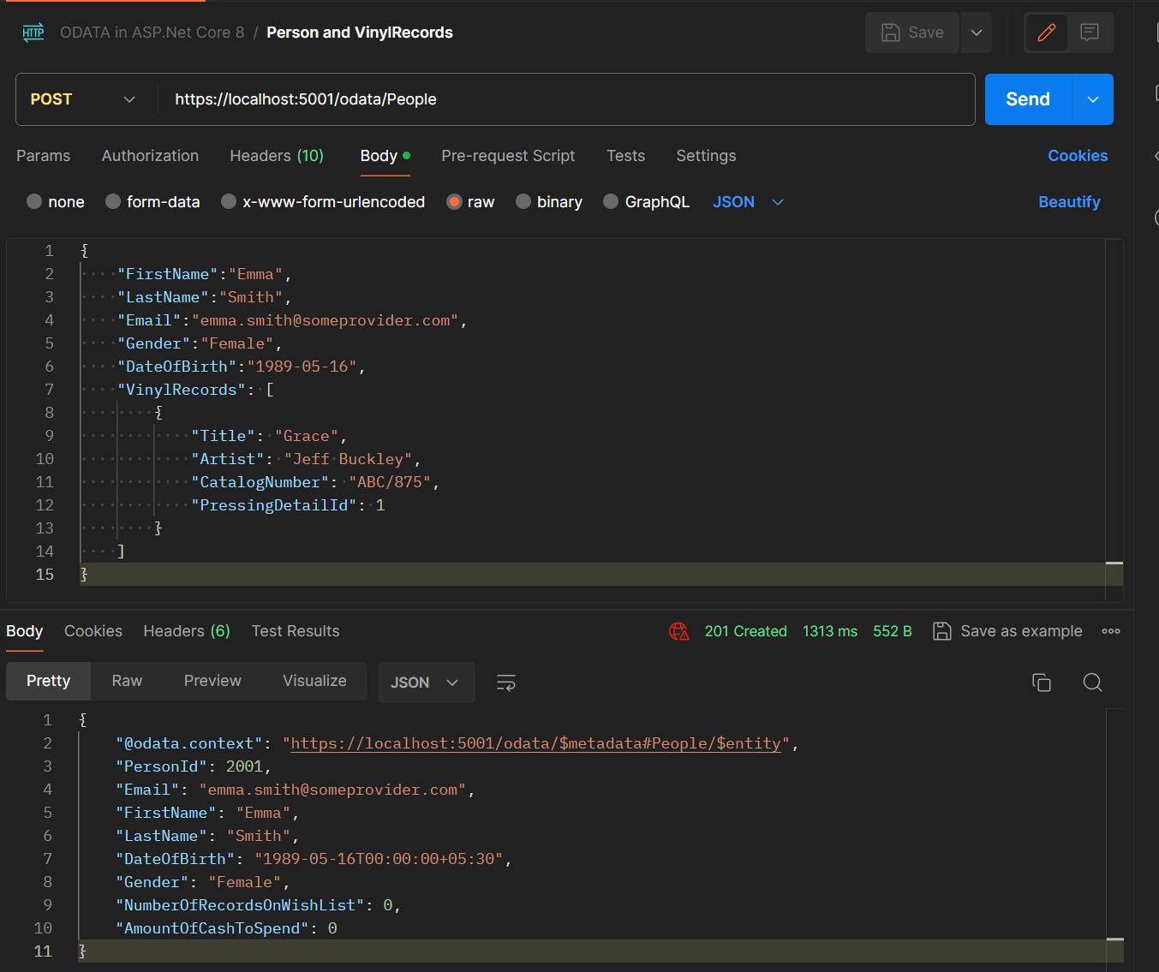

Slide 31
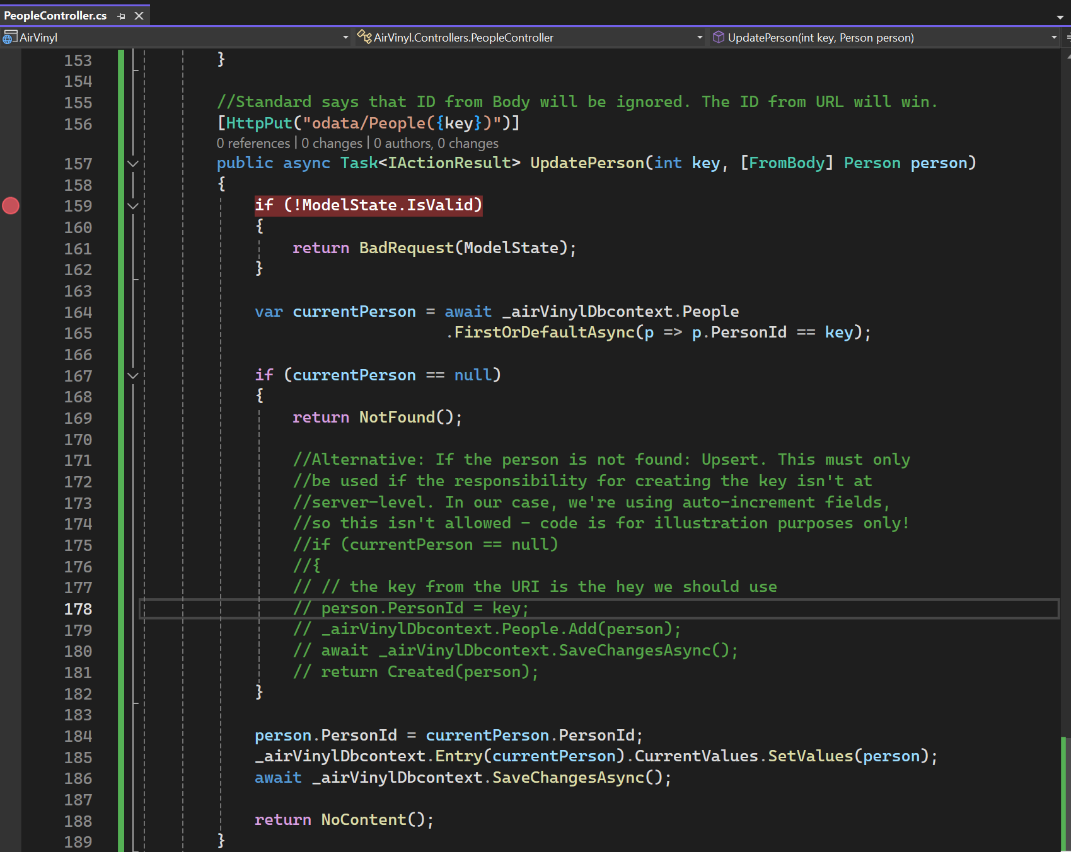

Slide 32
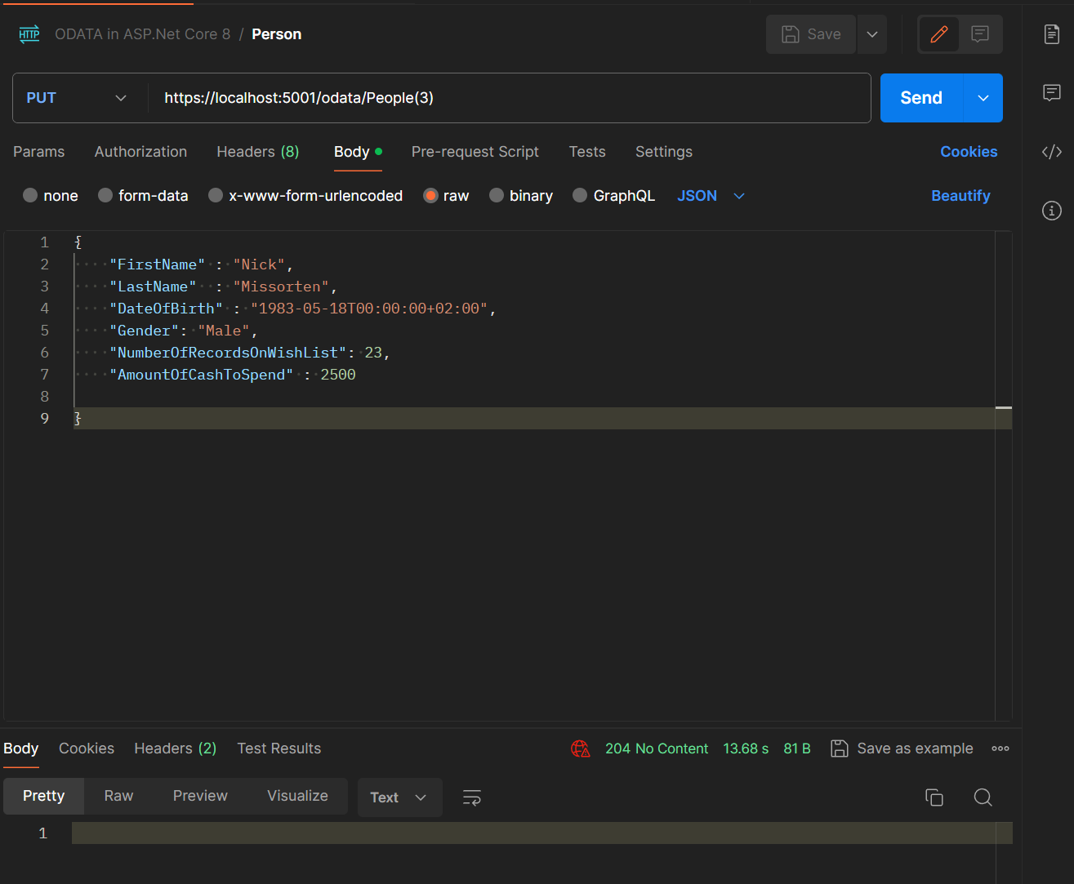

Slide 33
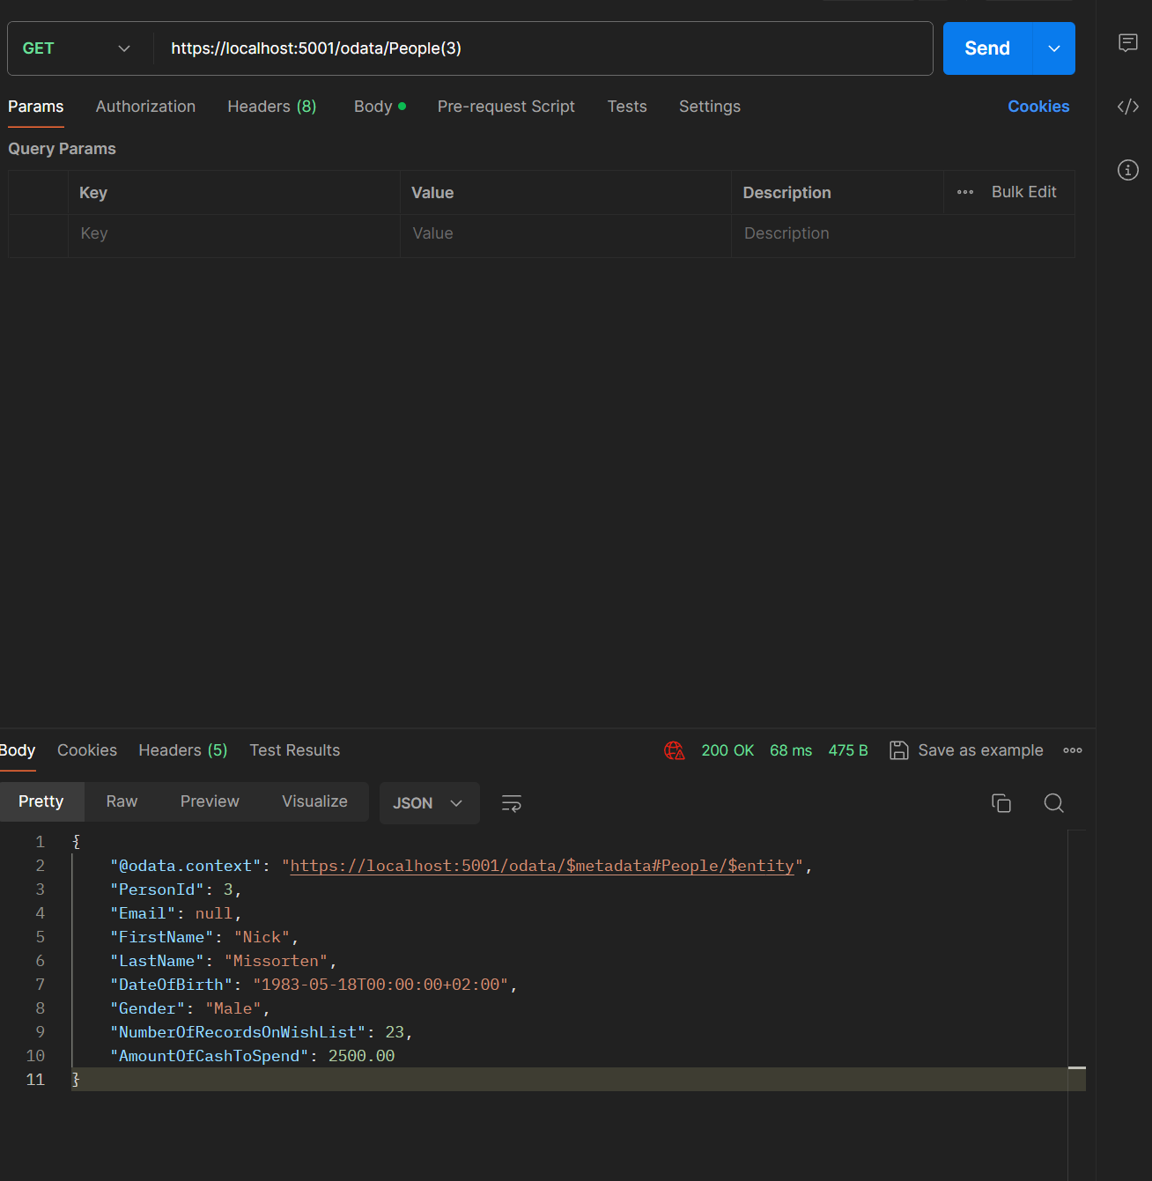

Slide 34
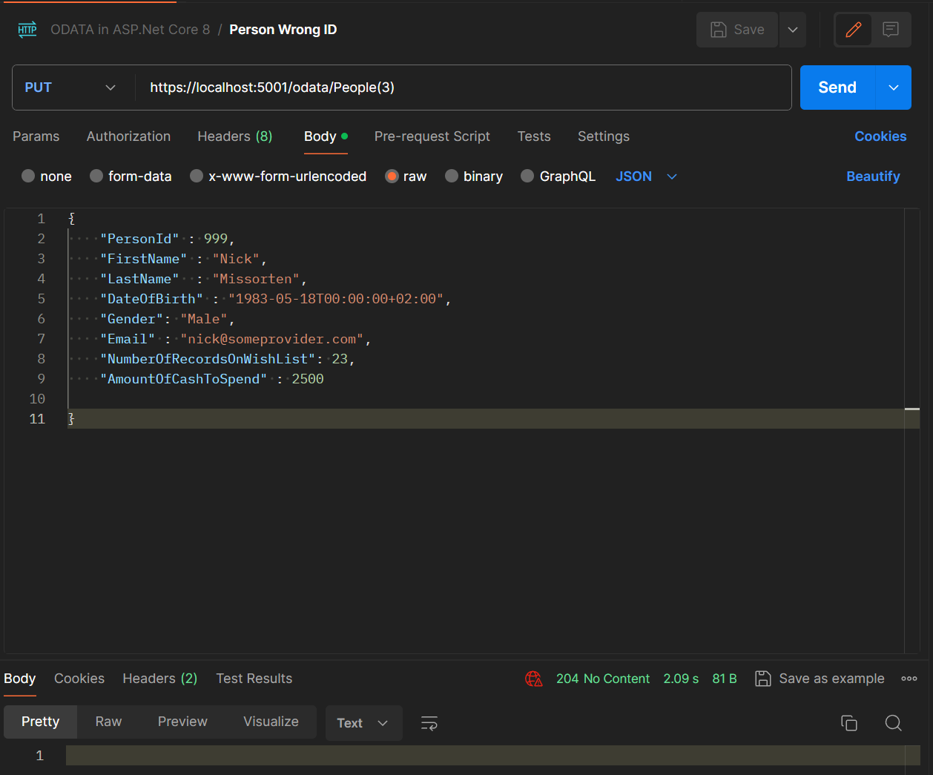

Slide 35
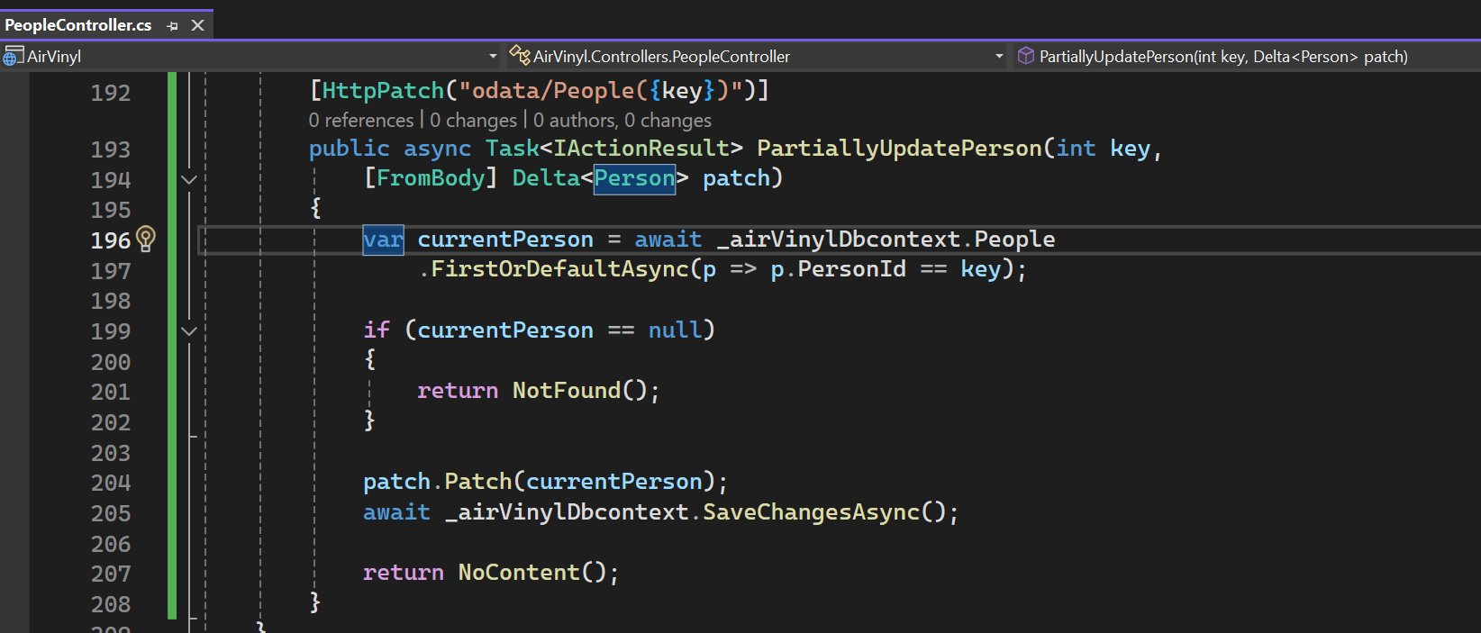

Slide 36
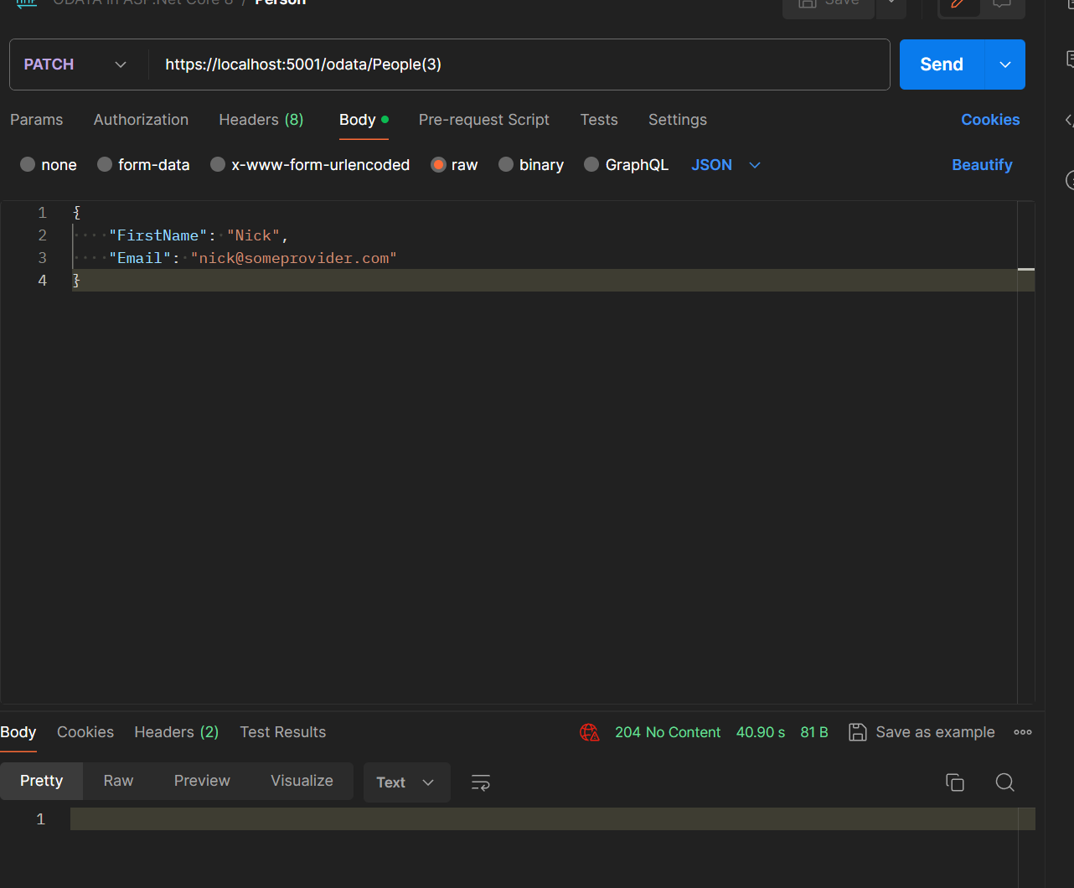

Slide 37
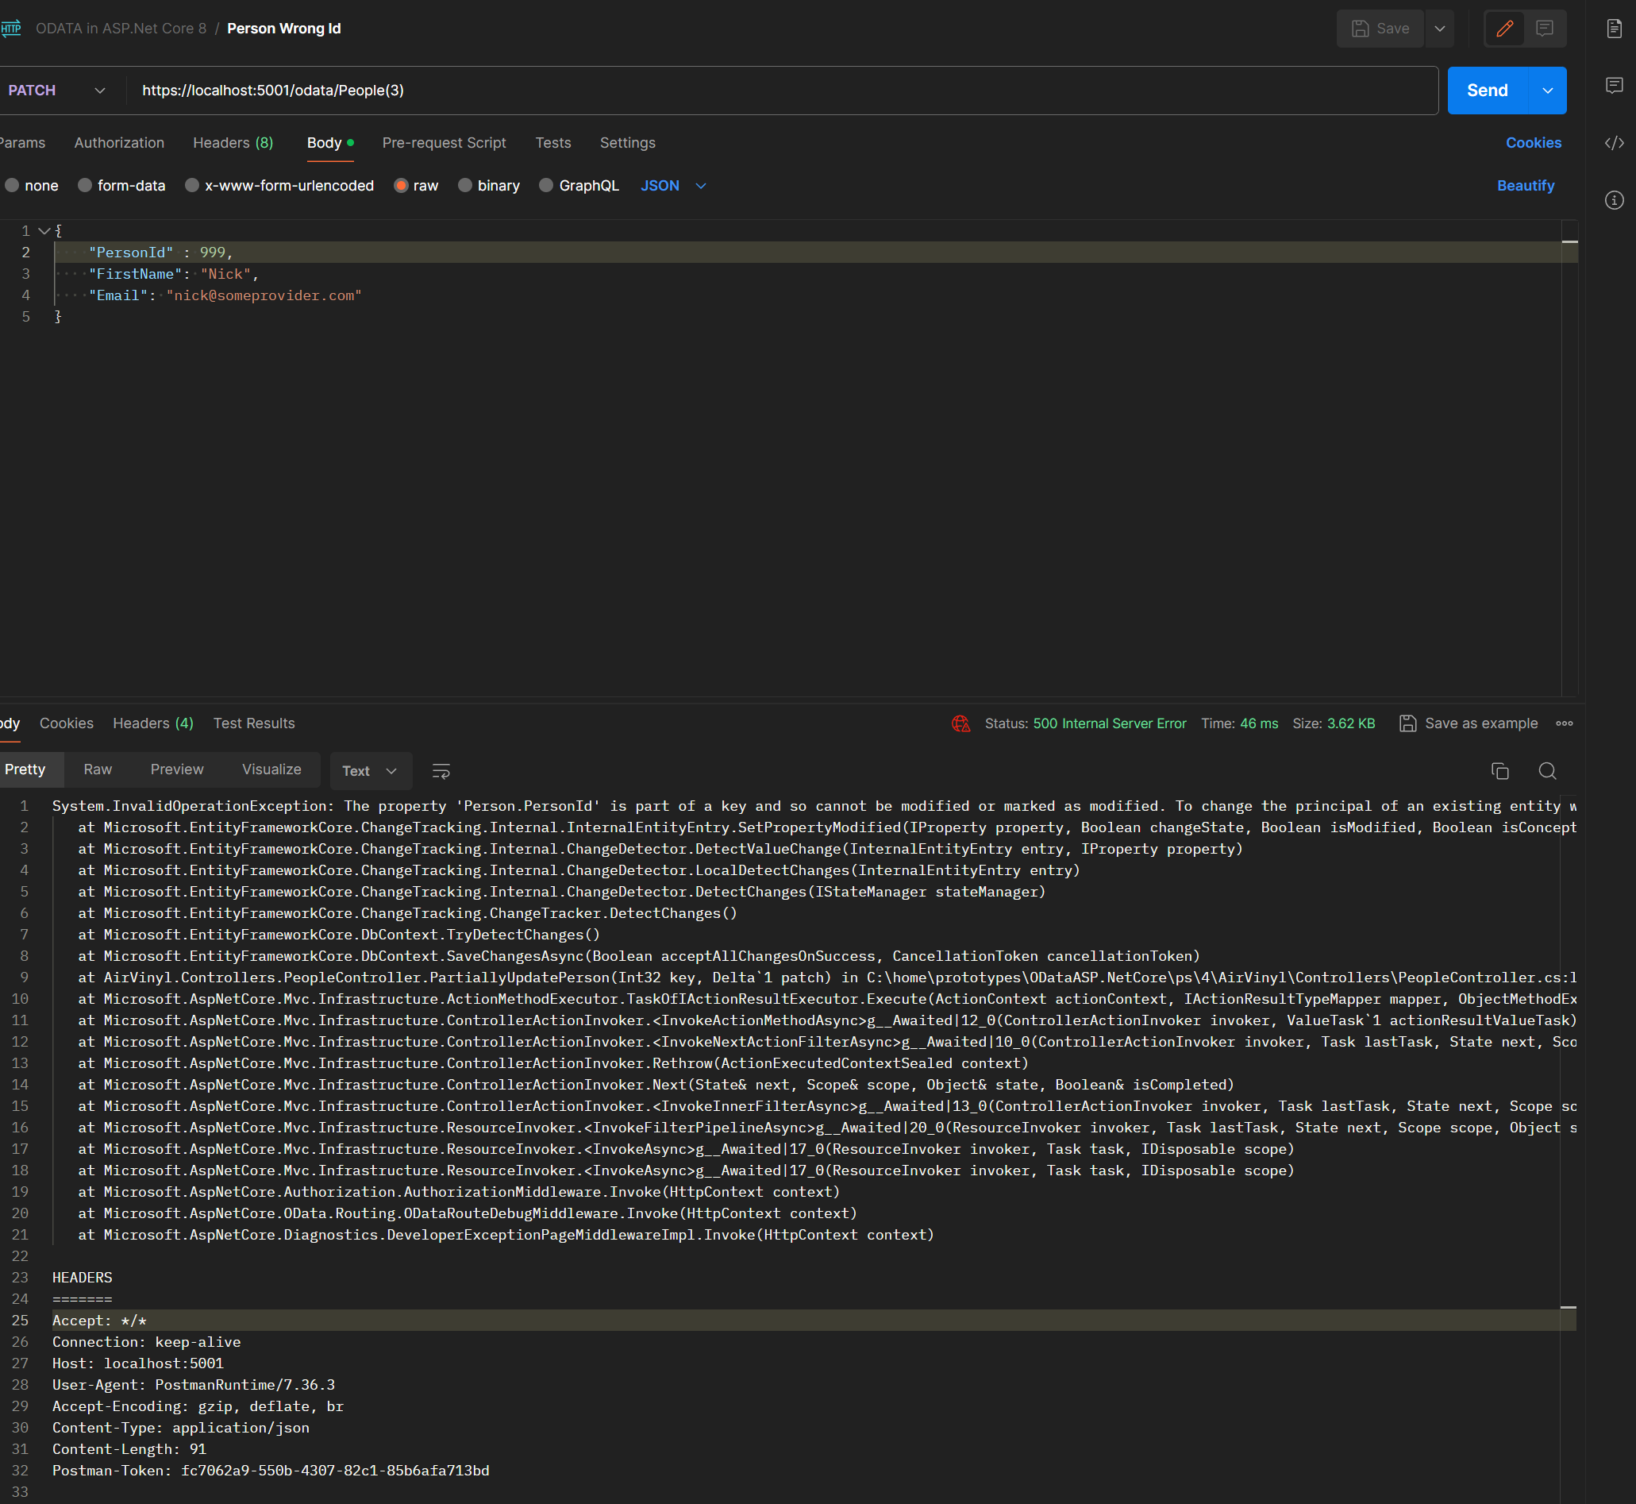

Slide 38
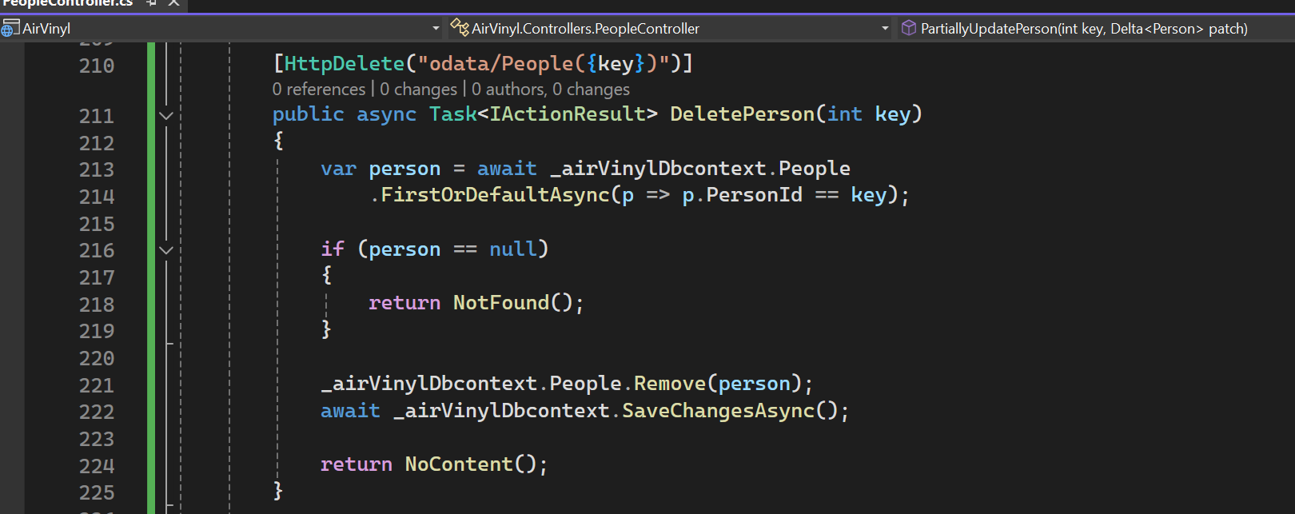

Slide 39
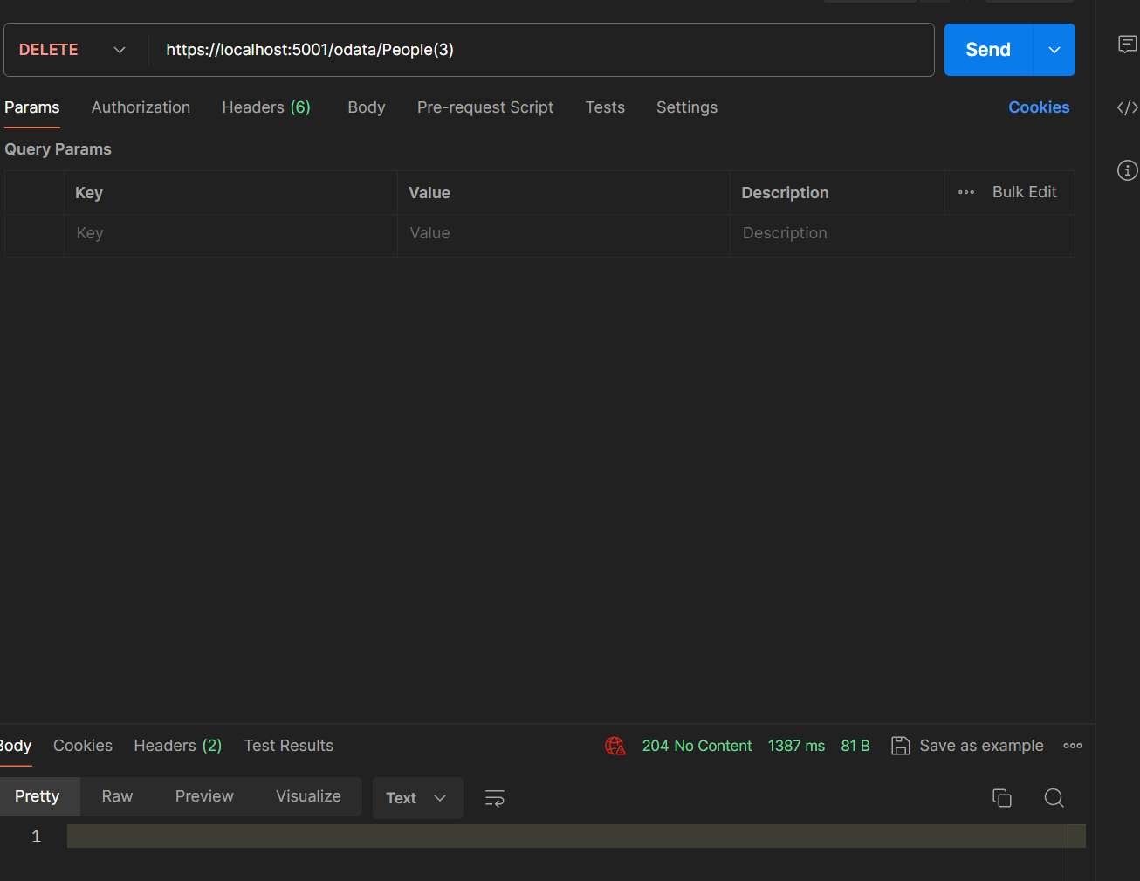

Slide 40
Querying Data

Slide 41
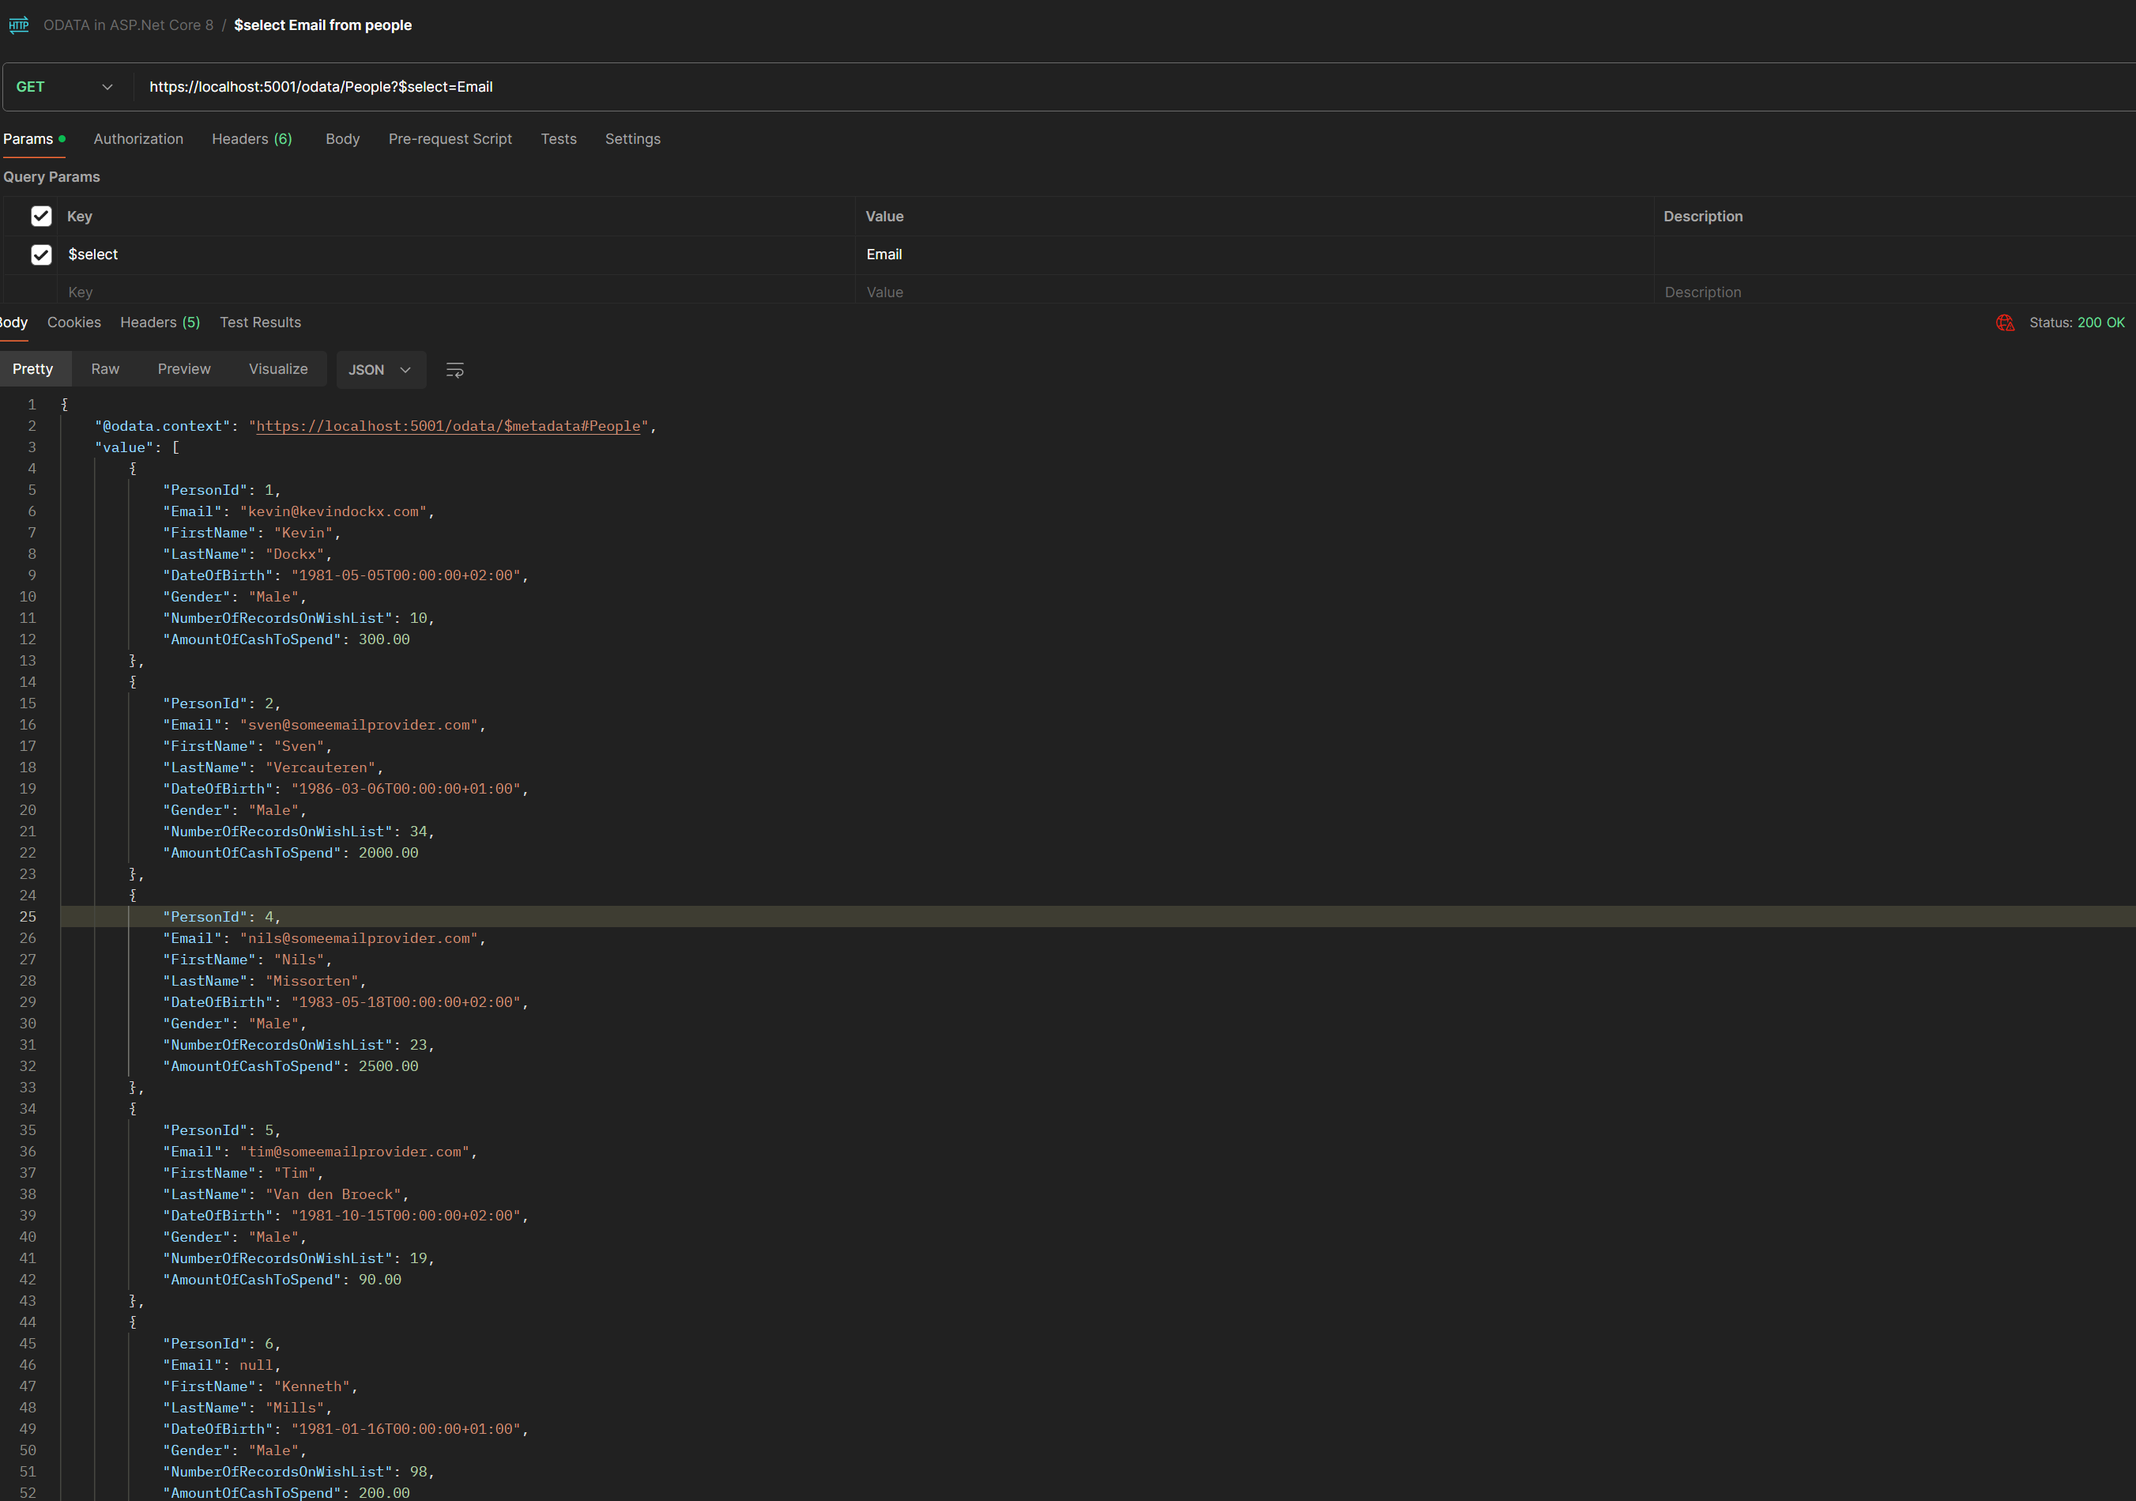
Selecting Specific Properties

Slide 42
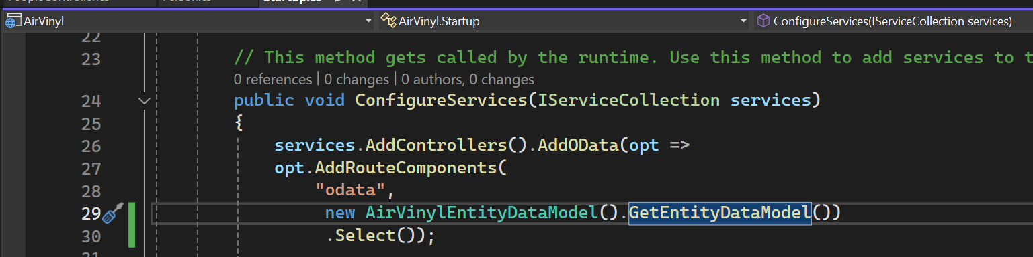
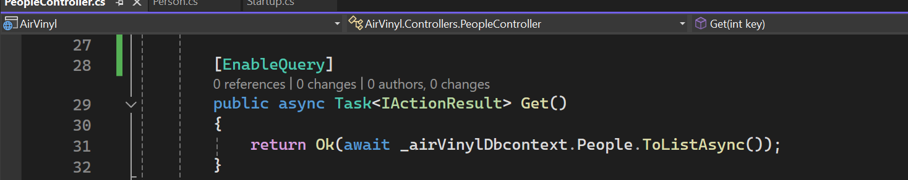
Selecting Specific Properties -2

Slide 43
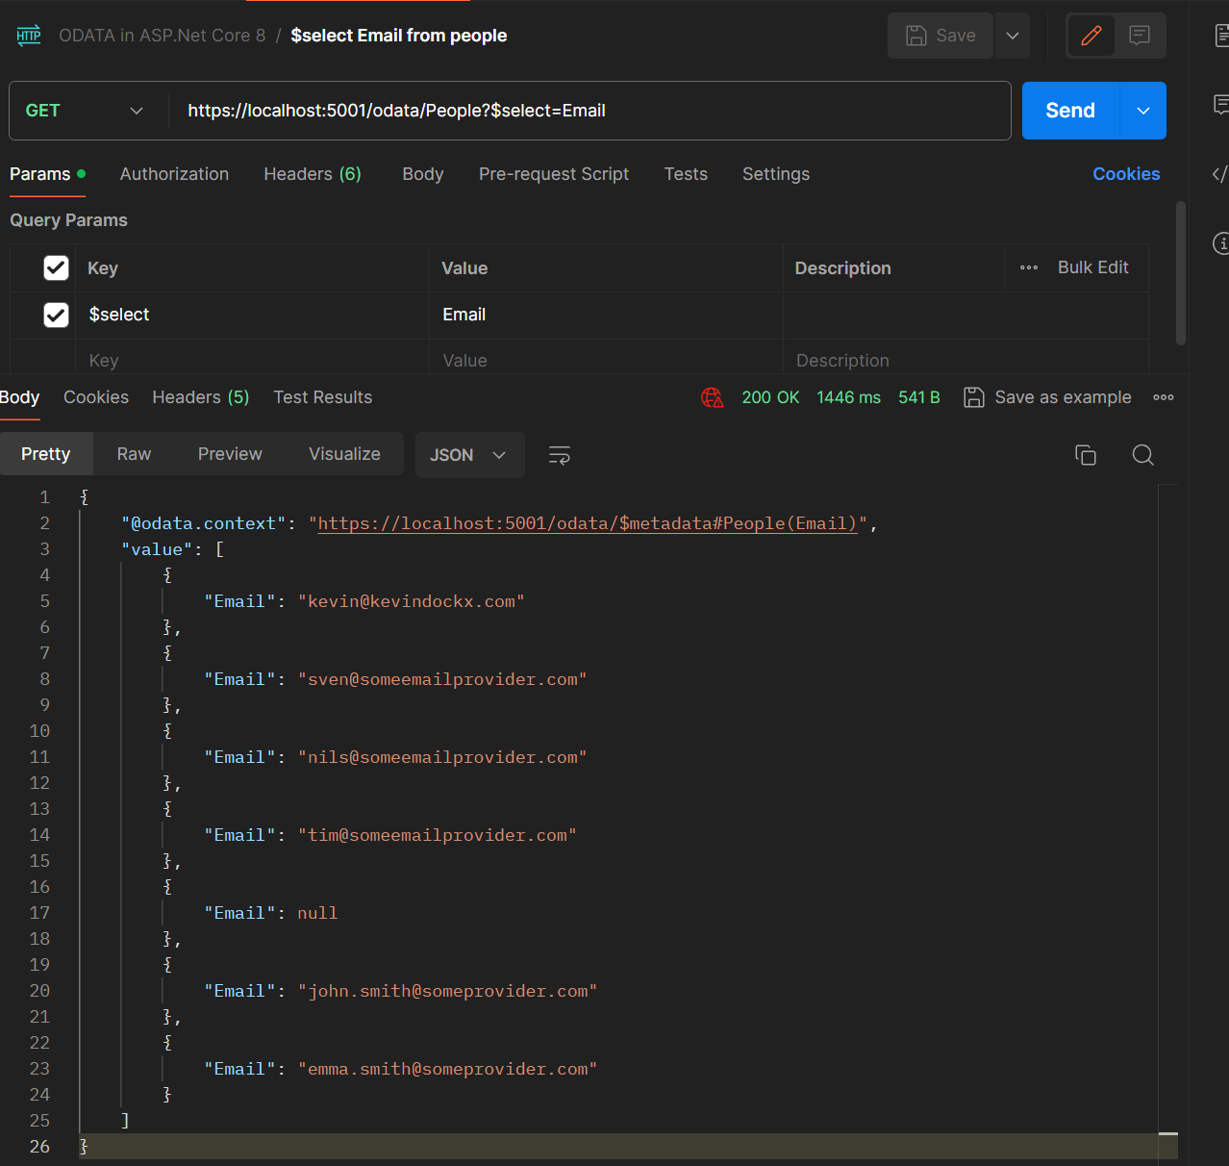
Selecting Specific Properties -3

Slide 44
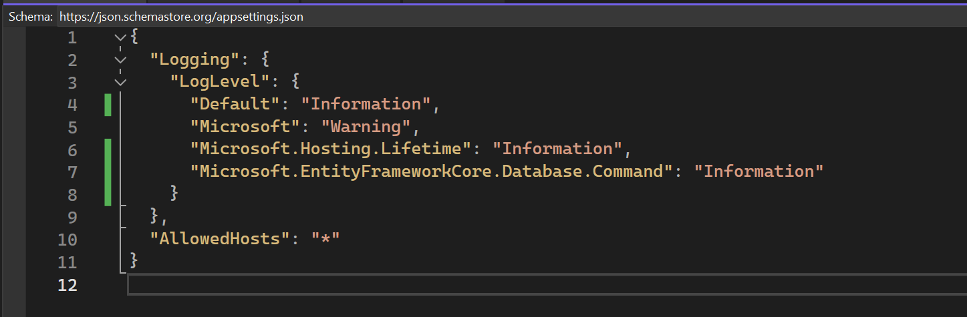
Selecting Specific Properties -4

Slide 45
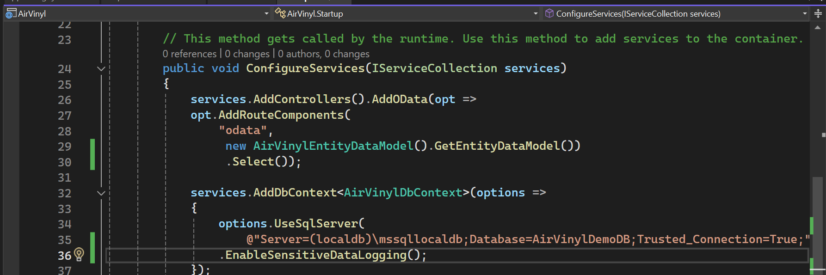
Selecting Specific Properties -5

Slide 46
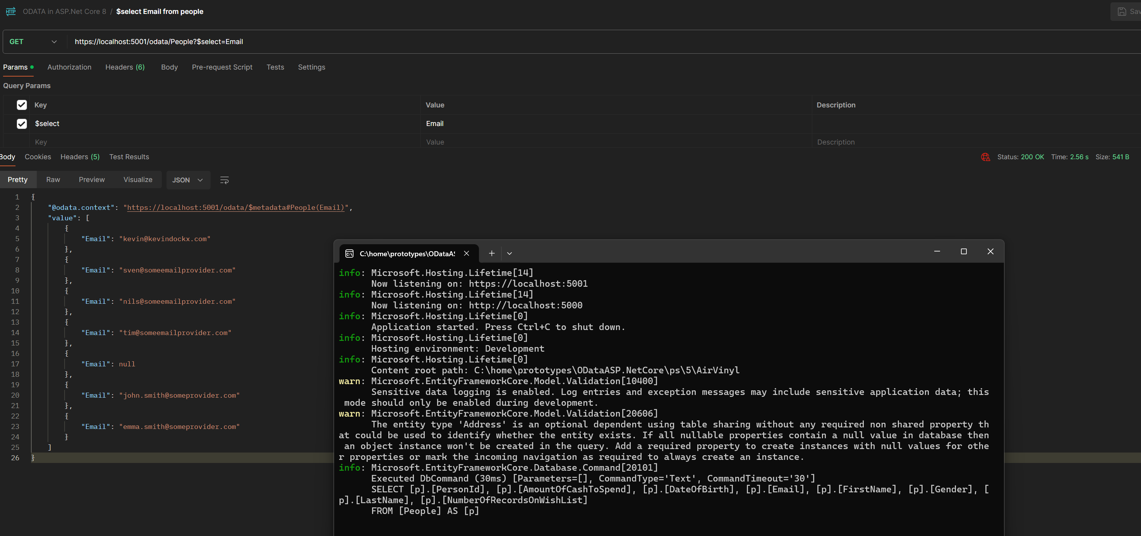
Selecting Specific Properties -6

Slide 47
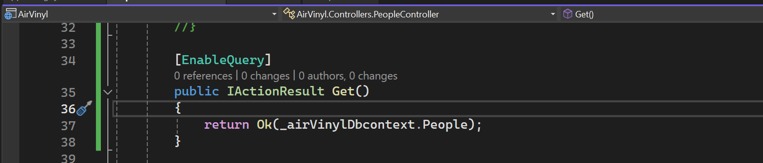
Selecting Specific Properties -7

Slide 48
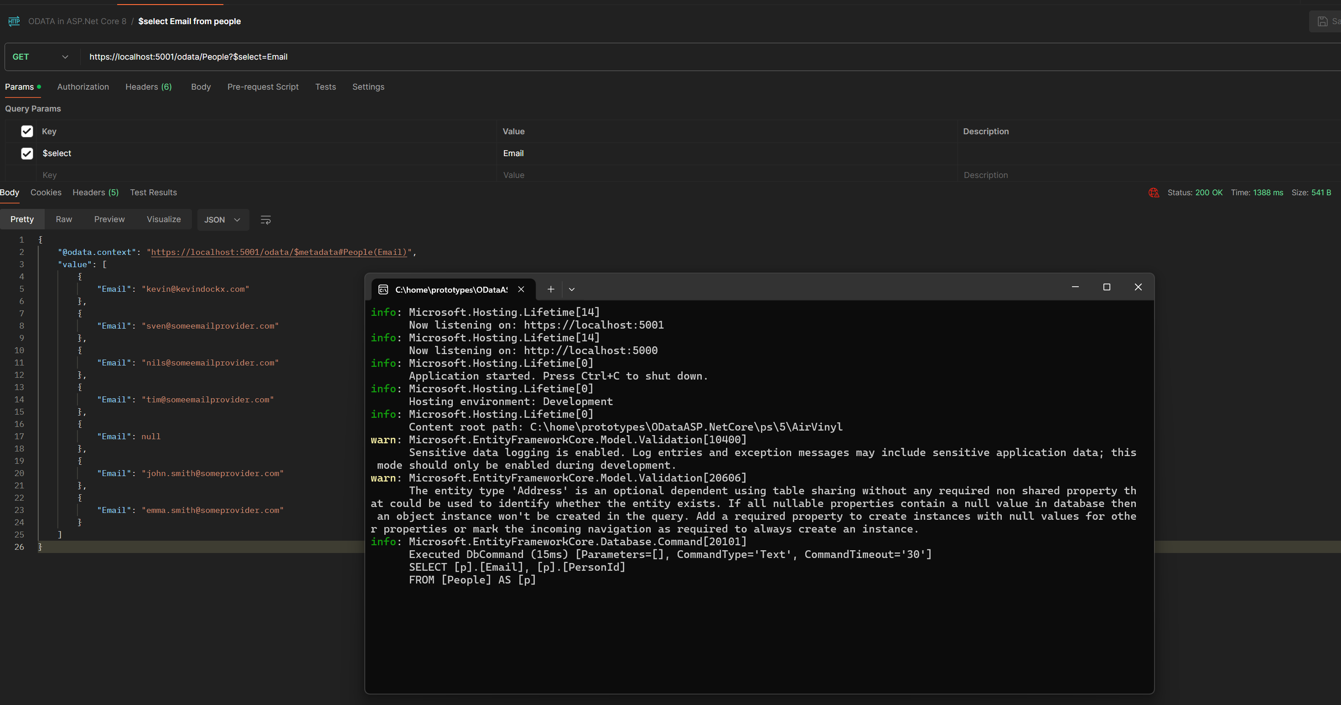
Selecting Specific Properties -8

Slide 49
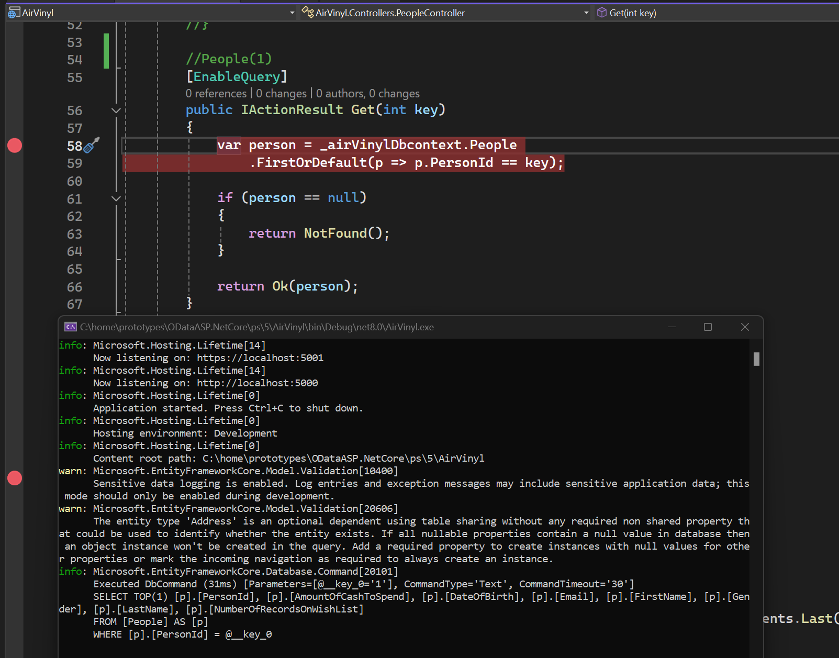
Selecting Specific Properties – Part 2

Slide 50
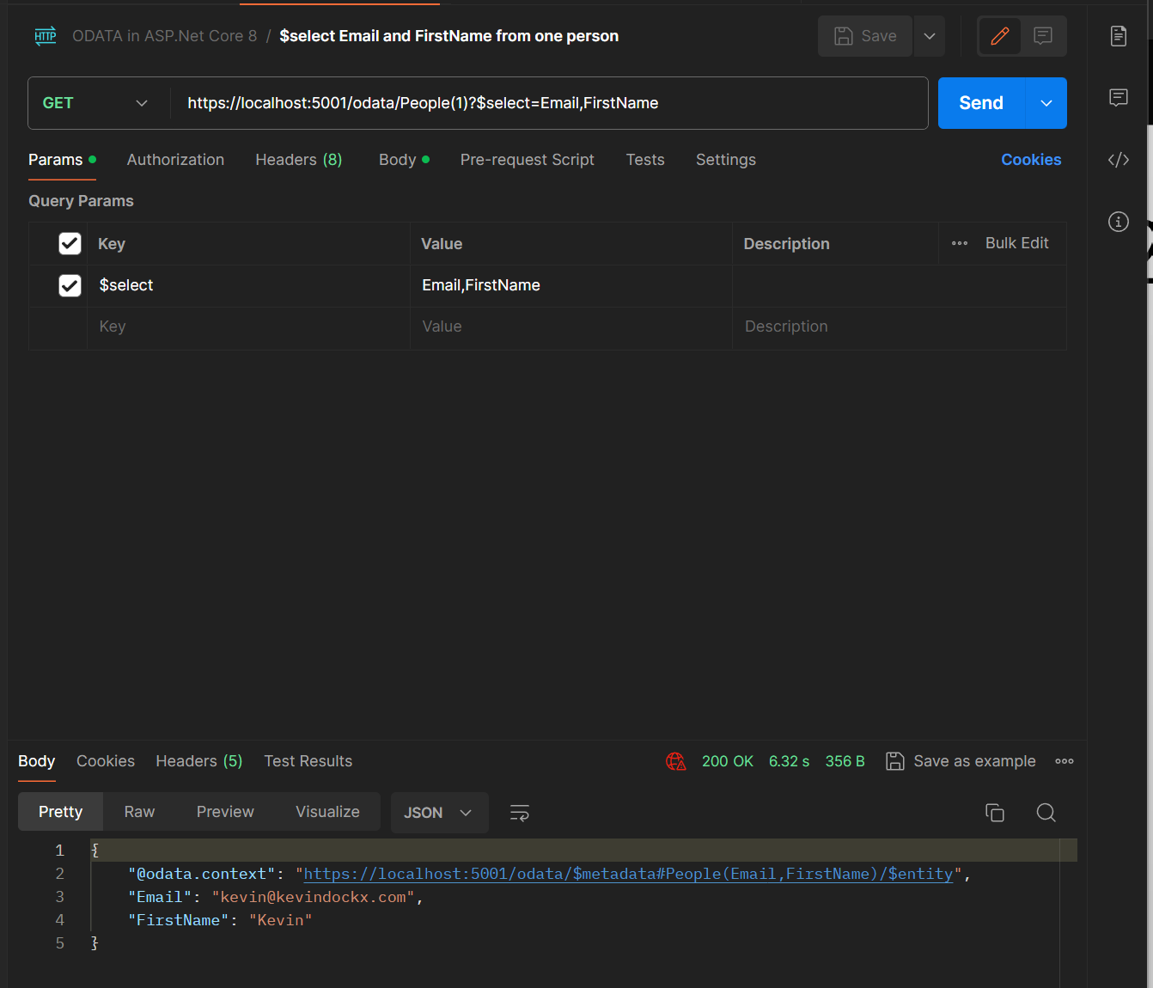
Selecting Specific Properties – Part 2 / 1

Slide 51
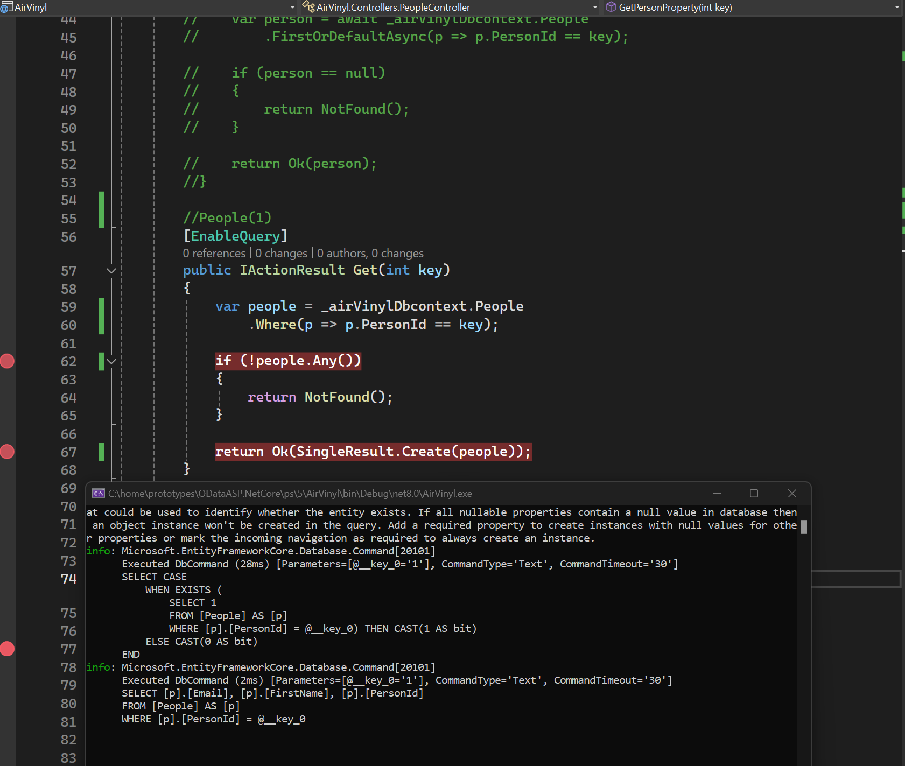
Selecting Specific Properties – Part 2 / 2

Slide 52

Selecting Specific Properties – Part 2 / 3

Slide 53

Selecting Specific Properties – Part 2 / 4

Slide 54

Selecting Specific Properties – Part 2 / 5

Slide 55

Selecting Specific Properties – Part 2 / 6

Slide 56

Selecting Specific Properties – Part 2 / 7

Slide 57

Including Related Entities - 1

Slide 58

Including Related Entities - 2

Slide 59

Including Related Entities - 3

Slide 60

Including Related Entities - 4

Slide 61

Including Related Entities - 5

Slide 62

Including Related Entities - 6

Slide 63

Including Related Entities - 7

Slide 64

Including Related Entities - 8

Slide 65

Including Related Entities - 9

Slide 66

Including Related Entities - 10

Slide 67

Queries – Ordering Entities

Slide 68

Orderby

Slide 69

Orderby

Slide 70

Orderby

Slide 71

Orderby

Slide 72

Orderby

Slide 73

Orderby

Slide 74

Paging

Slide 75

Paging

Slide 76

Paging

Slide 77

Paging

Slide 78

Paging

Slide 79

Paging

Slide 80

Paging

Slide 81

Paging

Slide 82

Paging

Slide 83

Paging

Slide 84

paging

Slide 85

Paging

Slide 86

paging

Slide 87

paging

Slide 88

filter

Slide 89

filter

Slide 90

filter

Slide 91

filter

Slide 92

filter

Slide 93

filter

Slide 94

filter

Slide 95

filter

Slide 96

filter

Slide 97

Arithmetic operators

Slide 98

Precedence and grouping operators

Slide 99

Precedence and grouping operators

Slide 100

Cannonical functions

Slide 101

Cannonical functions

Slide 102

Cannonical functions

Slide 103
Cannonical functions

Slide 104

Cannonical functions

Slide 105

Implict Literal

Slide 106

Implict Literal - 1

Slide 107

Implict Literal - 2

Slide 108

Implict Literal - 3

Slide 109
Working with Containment Navigation, Custom Functions, Actions and Singletons

Slide 110

Support Containment Navigation - 1

Slide 111

Support Containment Navigation - 2

Slide 112

Support Containment Navigation - 3

Slide 113

Support Containment Navigation - 3

Slide 114

Support Containment Navigation - 4

Slide 115

Support Containment Navigation - 5

Slide 116

Support Containment Navigation - 6

Slide 117

Support Containment Navigation - 7

Slide 118

Manipulating Containment Navigation Properties

Slide 119

Manipulating Containment Navigation Properties

Slide 120

Manipulating Containment Navigation Properties

Slide 121

POST

Slide 122

PATCH

Slide 123

GET

Slide 124

DELETE

Slide 125

GET

Slide 126

Supporting a Custom Function

Slide 127

Check Metadata

Slide 128

Supporting a custom function

Slide 129

Supporting a custom function bound to an entity collection

Slide 130

Supporting a custom function bound to an entity collection

Slide 131

Supporting a custom function bound to an entity collection

Slide 132

Supporting a custom function bound to an entity collection

Slide 133

Supporting a custom function bound to an entity collection

Slide 134

Supporting an unbound custom function

Slide 135

Supporting an unbound custom function

Slide 136

Supporting an unbound custom function

Slide 137

Supporting an unbound custom function

Slide 138

Supporting a custom action

Slide 139

Supporting a custom action

Slide 140

Supporting a custom action

Slide 141

Supporting a custom action

Slide 142

Supporting a custom action

Slide 143

Supporting a custom bound to an entity collection

Slide 144

Supporting a custom bound to an entity collection

Slide 145

Supporting a custom bound to an entity collection

Slide 146

Supporting an unbound custom action

Slide 147

Supporting an unbound custom action

Slide 148

Singleton

Slide 149

Supporting a singleton

Slide 150

Manipulating a Singleton

Slide 151

check

Slide 152
Working with Derived Types, Open Types and Batch Processing

Slide 153

Inspect Metadata

Slide 154

Specialized RecordStore

Slide 155

SpecializedRecordStore

Slide 156

Working with derived types

Slide 157

Working with derived types

Slide 158

Working with derived types

Slide 159

Working with derived types

Slide 160

Querying Derived Types

Slide 161

Querying Derived Types

Slide 162

Querying Derived Types

Slide 163


Querying Data Types

Slide 164

Querying Data Types

Slide 165

Querying Data Types

Slide 166

Querying Data Types

Slide 167

Manipulating Derived Types

Slide 168

Manipulating Derived Types

Slide 169

Manipulating Derived Types

Slide 170

Manipulating Derived Types

Slide 171

Manipulating Derived Types

Slide 172

Manipulating Derived Types
Note: Need to find out the reason why it is not allowed

Slide 173

Manipulating Derived Types

Slide 174

Manipulating Derived Types

Slide 175

Manipulating Derived Types

Slide 176

Open Types

Slide 177

Open Types

Slide 178

Open Types

Slide 179

Open Types

Slide 180

Open Types

Slide 181

Open Types

Slide 182

Open Types

Slide 183

Open Types

Slide 184

Open Types - Get

Slide 185

OPEN TYPES - POST

Slide 186

HTTP PATCH

Slide 187

PATCH

Slide 188

GET

Slide 189

BATCH PROCESSING

Slide 190

BATCH PROCESSING

Slide 191

BATCH PROCESSING

Slide 192

BATCH PROCESSING

Slide 193

BATCH PROCESSING - 1

Slide 194

BATCH PROCESSING - 2

Slide 196
Consuming an ODATA

Slide 197

AirVinylClient

Slide 198

Requesting data with POCOS

Slide 199

Requesting data with POCOS

Slide 200

Requesting data with POCOS

Slide 201

Requesting data with POCOS

Slide 202

Requesting data with POCOS

Slide 203

Requesting data with POCOS

Slide 204

Requesting data with POCOS

Slide 205

Requesting data with POCOS

Slide 206

Interacting through POCOS

Slide 207

AutoGenerated Client

Slide 208

EXTENSION

Slide 209

Connected Service - 1

Slide 210

Connected Service - 2

Slide 211

Connected Service - 3

Slide 212

Connected Service - 4

Slide 213

Connected Service - 5

Slide 214

Auto generated client

Slide 215

Auto generated client

Slide 216

Auto generated client

Slide 217

Auto generated client

Slide 218

Auto generated client

Slide 219

Auto generated client

Slide 220

BATCH Client

Slide 221

BATCH Client

Slide 222
Javascript Clients

Slide 223


For Node.JS
LINQ

Slide 224

For Angular
Fully featured. Client-side querying, caching, change tracking and so on all are included.

Slide 225

Suggested by ODATA team

Slide 226

Razor Pages

Slide 227

Create Project

Slide 228

Razor Pages - Create

Slide 229


Slide 230



Minification Javascript

Slide 231

Adding the library

Slide 232

Reading and Querying data

Slide 233

Reading and Querying data

Slide 234

Reading and Querying data

Slide 235

Reading and Querying data

Slide 236

Reading and Querying data

Slide 237

Reading and Querying data

Slide 238

Manipulating Data

Slide 239

Manipulating Data

Slide 240

Manipulating Data

Slide 241

Manipulating Data

Slide 242

Manipulating Data

Slide 243

Manipulating Data

Slide 244

Manipulating Data

Slide 245

Mainpulation of Data

